Slide 1

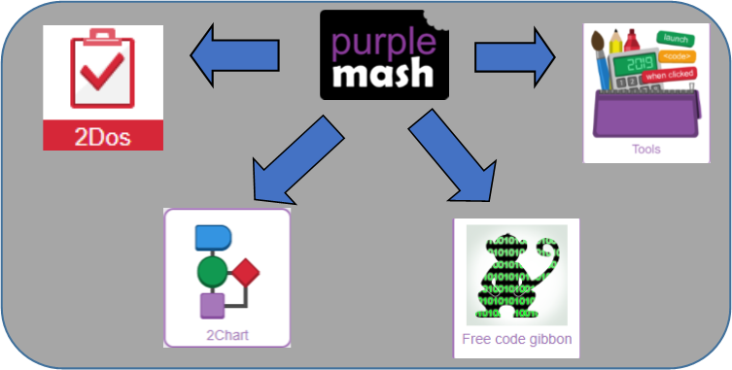
Year 4
Computing
Autumn Term
Key Vocabulary
Action | Types of commands, which are run on an object. They could be used to move an object or change a property.
Algorithm | A precise step by step set of instructions used to solve a problem or achieve an objective.
Command | A single instruction in a computer program.
Design Mode | Used to create the look of a 2Code computer program when it is run.
If/else | A conditional command that tests a statement. If the condition is true, then the commands inside the ‘if block’ will be run. If the condition is not met, then the commands inside the ‘else block’ are run.
Input | Information going into the computer. Can include moving or clicking the mouse, using the keyboard, swiping and tilting the device.
Repeat | This command can be used to make a block of commands run a set number of times or forever.
Timer | Use this command to run a block of commands after a timed delay or at regular intervals.
Variable | A named area in computer memory. A variable has a name and a value. The program can change this variable value.
Key Learning
To use selection in coding with the ‘if/else’ command.
To understand and use variables in 2Code.
To use flowcharts for design of algorithms including selection.
To use the ‘repeat until’ with variables to determine the repeat.
To learn about and use computational thinking terms decomposition and abstraction.
Key Resources

Slide 2
9 hours over Autumn Term
2 Type Activity
Internet Safety
Passwords
Internet Safety
Searching for Images
Coding: Lesson 1
To review coding vocabulary.
To use a sketch or storyboard to represent a program design and algorithm.
To use the design to create a program.
Coding: Lesson 2
To use if/else statements in a program.
To create a variable.
To explore a flowchart design for a program with an if/else statement.
Coding: Lesson 3
To create a program with a character that repeats actions.
To use the Repeat Until command to make characters repeat actions.
To program a character to respond to user keyboard input.
Coding: Lesson 4
To make timers and counting machines using variables to print a new number to the screen every second.
Coding: Lesson 5
To explore how 2Code can be used to investigate control by creating a simulation.
Coding: Lesson 6
To know what decomposition and abstraction are in computer science.
To design a decomposed feature of a real life situation.

