Slide 1

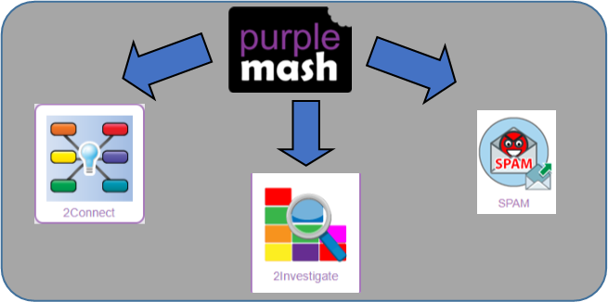
Year 4
Computing
Spring Term
Key Vocabulary
Computer Virus | A piece of code which can copy itself and typically has a damaging effect on the device, such as corrupting the system or destroying data.
Cookies | A small amount of data generated by a website and saved by a web browser. Its purpose is to remember information about the user.
Copyright | When the rights to something belong to a specific person.
Digital Footprint | The information about a person that exists on the Internet as a result of their online activity.
Email | Messages sent by electronic means from one device to one or more people.
Identity Theft | When a person pretends to be someone else.
Malware | Software that is specifically designed to disrupt, damage, or gain unauthorized access to a computer system.
Phishing | Practice of sending email pretending to be from reputable companies in order to persuade individuals to reveal personal information, such as passwords and credit cards numbers.
Plagiarism | When you use someone else's words or ideas and pass them off as your own.
Spam | Messages sent over the internet, typically to many users, for the purposes of advertising, phishing or spreading malware.
Key Learning
To understand how children can protect themselves from online identity theft.
Understand that information put online leaves a digital footprint or trail and that this can aid identity theft.
To Identify the risks and benefits of installing software including apps.
To understand that copying the work of others and presenting it as their own is called 'plagiarism' and to consider the consequences of plagiarism.
To identify appropriate behaviour when participating or contributing to collaborative online projects for learning.
To identify the positive and negative influences of technology on health and the environment.
To understand the importance of balancing game and screen time with other parts of their lives.
Key Resources

Slide 2
7 hours over Spring Term
2 Type Activity
Internet Safety
Meeting Up With a Gamer: Part 1
Internet Safety
Meeting Up With a Gamer: Part 2
Online Safety: Lesson 1
To understand how children can protect themselves from online identity theft.
Understand that information put online leaves a digital footprint or trail and that this can aid identity theft.
Online Safety: Lesson 2
To identify the risks and benefits of installing software including apps.
Online Safety: Lesson 3
To understand that copying the work of others and presenting it as their own is called 'plagiarism' and to consider the consequences of plagiarism.
To identify appropriate behaviour when participating or contributing to collaborative online projects for learning.
Online Safety: Lesson 4
To identify the positive and negative influences of technology on health and the environment.
To understand the importance of balancing game and screen time with other parts of their lives.

