Slide 1

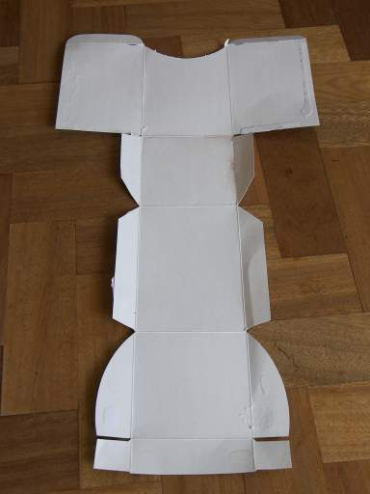
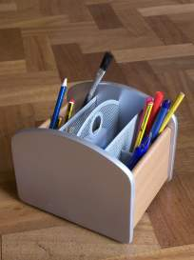
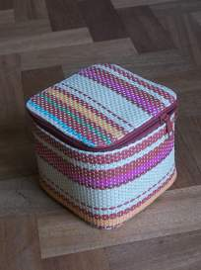
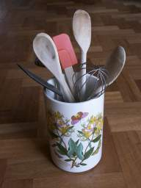
Year 4– Autumn Term
Desk tidy – Structure
Key Vocabulary
Net | 2D representation of a 3D shape
Container | an object for holding or transporting something.
Packaging | materials used to wrap or protect goods
Biodegradable | capable of being decomposed by bacteria or other living organisms and thereby avoiding pollution.
Strong | Withstand force.
Stable | Unlikely to fall over.
Compartments | a separate section or part of a structure or container.

Slide 2
Lesson sequence
Evaluation of existing products | Does your workspace need organising? Do you need to put things where you can find them easily? Take a closer look at some of the packaging you throw away. What shape is it? Why do you think it is this shape? What materials is it made from?
Focussed tasks | Look for the shapes that made the sides of your packaging. Could you have made the net by joining the sides in a different way? See additional resources for more information.
Design | Who is the desk tidy going to be for? Where will the desk tidy be used? What will the user put in the desk tidy? What packaging could you use? What other reclaimed materials could you add? Does the user need any special features? i.e. a handle, compartments
Make | Create their desk tidy using the skills learnt.
Evaluate | What reclaimed materials were used in making your desk tidy? What decoration did you use to finish the desk tidy off? If you made another desk tidy, would you make it differently?
Health and Safety

