Slide 1

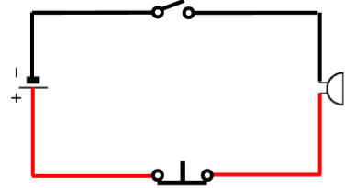
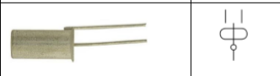
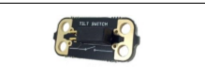
Year 4– Spring Term
Night light
Simple circuit
Key Vocabulary
Input | The place at which energy enters.
Output | Where the power or information leaves in the system.
Tilt Switch | Two electrical contacts and a material which acts as a conductor between the two electrical contacts.
Circuit | A closed path through which an electric current flows or may flow
Conductor | An electrical conductor is a substance in which electrical charge carriers.
Series/simple circuit | Electric circuit in which the electric passes through each circuit element in order.
Tilt switch

Slide 2
Lesson sequence
Evaluation of existing products | Discuss examples night lights– where and why they are used? Who usually wants them? How does that impact the designs?
Focussed tasks | Build a working circuit using a battery, switch, such as a tilt, reed or push-to-make switch, and light. Draw a pictorial representation of the circuit or draw a circuit diagram using correct symbols.
Design | Designing The design is for a night light for a specific person.
Make | Making Circuits will need an on-off switch to activate the circuit as well as the switch that triggers the light.
Evaluate | Ask children to compare their final product to the original design specification. • Where possible they should test their products with the intended user and critically evaluate the quality of the design, manufacture, functionality and fitness for purpose.
Health and Safety | Remind children of the dangers of mains electricity. Explain how lithium in batteries is harmful.

