Slide 1

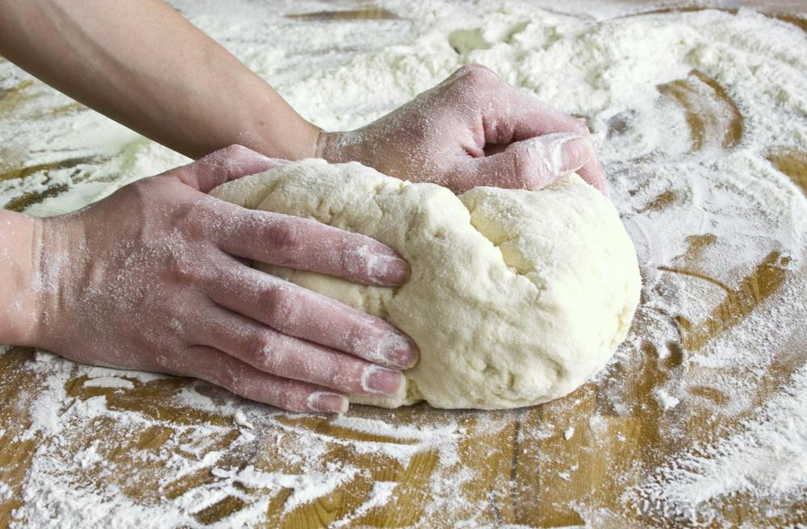
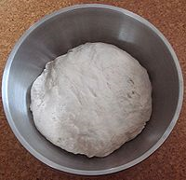
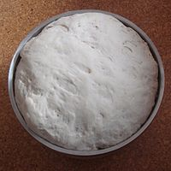
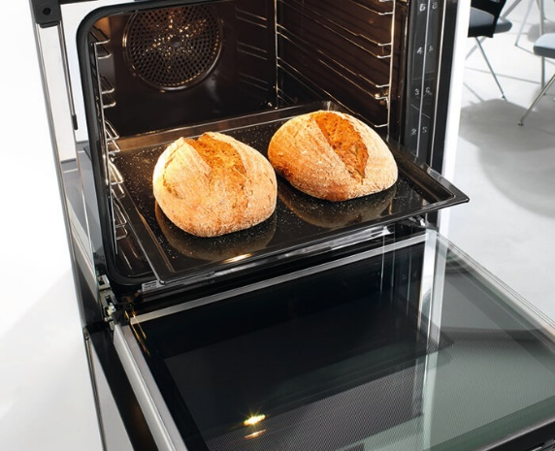
Year 4– Summer Term
Baking bread
Kneading bread
Key Vocabulary
Yeast | The rising agent in bread.
Rise | The increase of the size of the bread when baked.
Knead | To work the dough with your hands.
Optimum | The right amount of something.
Temperature | How hot something is.
Celsius | The measurement of temperature.
Prove | The aeration of dough to rise.
Aeration | To put air into something.
Proving
Oven baked

Slide 2
Lesson sequence
Evaluation of existing products | Ensure pupils spend lots of time looking at bread products. We tried to ensure the pupils had experience of as many different and unusual sorts of bread as possible.
Focussed tasks | Work as a whole class rather than small groups to practice making bread and learning the skills of kneading, chopping and shaping.
Design | We used Positive Minus Interesting (PMI) as a technique for designing our bread products. Pupils worked in small groups and considered three possible design proposals before deciding on a final design
Make | Each group had a basic bread recipe to follow, they also had the information from their yeast investigations to inform them about which sugar to use, the temperature of the liquid and the optimum time for proving.
Evaluate | Consider using alternative methods of evaluating. Our pupils do find this element tricky. We have had lots of discussions with the pupils about how we could make this stage more accessible to all.
Health and Safety | Use of the oven hot baking trays etc. Use of knives. Taught in groups to maximise safety.

