Slide 1
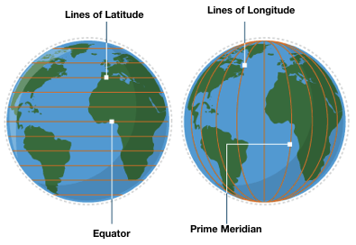
Knowledge Organiser – Year 4 Geography Spatial Sense
Key Vocabulary | Definition
Lines of Latitude | Imaginary lines that help us identify how far north or south of the equator a location is.
Lines of Longitude | Imaginary lines that help us identify how far east or west of the Prime Meridian a location is.
Equator | An imaginary line that shows us the locations that are half way between the north and south pole. The Equator divides the earth into the Northern Hemisphere and the Southern Hemisphere.
Prime Meridian | The line of longitude that measures 0º and runs through Greenwich in London.
Tropic of Cancer | The most northern line of latitude where the sun can be directly overhead. Named after the constellation of Cancer.
Tropic of Capricorn | The most southern line of latitude where the sun can be directly overhead. Named after the constellation of Capricorn.
Scale | The representation of distance on a map.
Tropics of Cancer and Capricorn
Lines of Longitude and Latitude
Map Scale

Slide 2

Year 4
Geography
Spatial Sense
Lesson Series:
1. Globes and the Tropics (Reading Text - ‘The Equator’ By Izzi Howell)
2. Scale
3. Grid References
4. Our Local Area (Extended Write – Description of local area)
5. Our Local Area- Changes over Time
6. Assessment
National Curriculum Coverage:
Name and locate counties and cities of the United Kingdom, geographical regions and their identifying human and physical characteristics, key topographical features (including hills, mountains, coasts and rivers), and land-use patterns; and understand how some of these aspects have changed over time
Identify the position and significance of latitude, longitude, Equator, Northern Hemisphere, Southern Hemisphere, the Tropics of Cancer and Capricorn, Arctic and Antarctic Circle, the Prime/Greenwich Meridian and time zones (including day and night)
Value Links:
Reverence
Respect for all the earth and all its formations
Local Links:
Southport
Explore local landmarks in Southport
What you need to know:
Globes often have lines depicted on them that help us to identify the location of places around the world. These lines include lines of longitude and latitude.
The equator is an imaginary line that splits the Earth in two halves; the Northern Hemisphere and the Southern Hemisphere.
Lines of latitude tell us how far north or south from the equator a place is
Lines of longitude tell us how far east or west a location is from the Prime Meridian line. The Prime Meridian line is a longitudinal line that is calculated as zero degrees; it runs through Greenwich in London.
Maps are drawn to different scales, depending on what they are showing. A 1:25000 scale means that 1cm on the map represents 25000 cm (or 250 metres) on the ground. A 1: 1000 000 scale means 1cm represents 1km. A map that uses scale usually has a scale bar that gives you the information you need to work out distance between two places.
Grid references are a tool for identifying specific locations on a map. A simple grid reference consists of two pieces of information, sometimes a letter and a number, sometimes two numbers. Horizontal lines on a grid will have each square labelled with a letter or number. The horizontal grid lines are called ‘northings’ (latitude). If you go north, the latitude values increase. The vertical lines arecalled ‘eastings’ (longitude). Positive numbers are above the equator and negative numbers are below.

