Slide 1
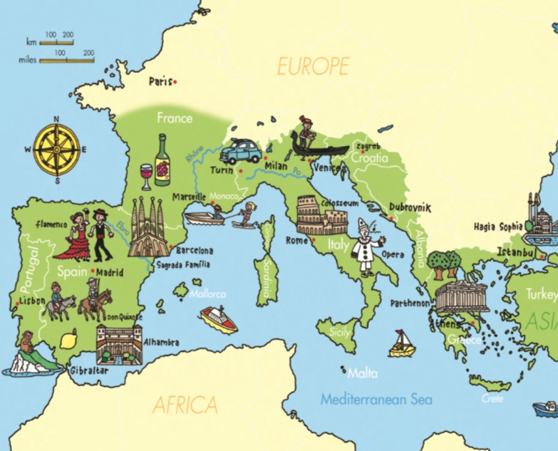
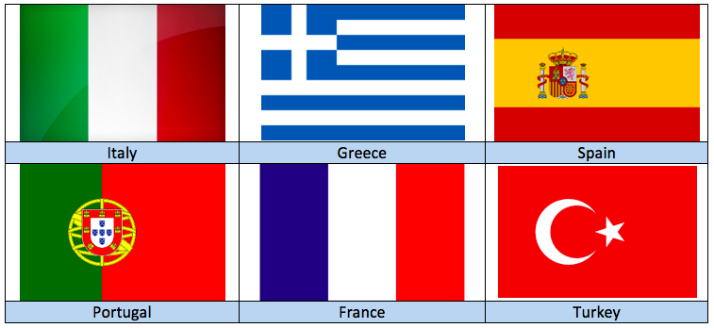
Knowledge Organiser – Year 4 Geography Mediterranean Europe
Map of Mediterranean Europe
Key Vocabulary | Definition
Mediterranean | From the Latin meaning ‘middle of the land’.
Equator | An imaginary line around the ‘middle’ of the Earth. The sun’s rays hit the equator directly, making the places located near to it very warm.
Latitude | Latitude is a measurement that gives the location of a place on Earth north or south of the equator. Maps sometimes show imaginary lines of latitude to help us locate places.
Ecosystem | A community of plants and animals found in a particular area.
The Gulf Stream | A current of warm water that flows from the Gulf of Mexico in Central America, all the way across the Atlantic Ocean to Europe.
Colosseum | An ancient, giant, oval shaped amphitheatre located in the centre of Rome. It was built during Ancient Roman times and gladiators fought there.
Peninsula | A region of land that sticks out in a body of water, with water on three sides.
Inhabit | To live or dwell in a place, as people or animals.
Country | Capital | Language
Italy | Rome | Italian
Spain | Madrid | Spanish
Portugal | Lisbon | Portuguese
Greece | Athens | Greek
Turkey | Ankara | Turkish
France (Southern) | Paris | French
Malta | Valletta | Maltese

Slide 2
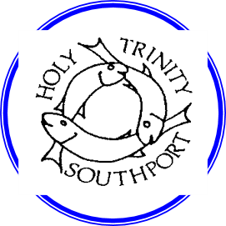
Value Links: Trust
We trust farmers in Mediterranean countries to produce good fruit and olives for us to eat.
Local Links:
Food and Farming
We research what food we import from the Mediterranean region
Lesson Series:
1. Key Places in Europe
2. Climate of Mediterranean Europe
(Reading Text – Newspaper Report ‘European Heatwave’ News Story)
3. Food and Farming
4. Landscape
5. Settlements
6. Assessment (Extended Write – Debate ‘Is Mediterranean Europe diverse?’)
National Curriculum Coverage:
Locational and Place Knowledge
• Locate the world’s countries, using maps to focus on Europe
• Use maps, atlases, globes and digital/computer mapping to locate countries and describe features studied
Year 4
Geography
Mediterranean Europe
What you need to know:
Southern Europe is sometimes called Mediterranean Europe because it is near the Mediterranean Sea. ‘Mediterranean’ comes from the Latin words meaning the middle of the land. The Mediterranean Sea is almost completely surrounded by three continents; Asia, Africa and Europe.
The key places in the Mediterranean for pupils to identify are: Southern France, Portugal, Spain, Italy, Greece, Malta, Cyprus and Turkey.
Mediterranean Europe is generally warmer than other regions in Europe. This is because they are further south and nearer to the Equator. The heat from the sun hits the earth more directly near the Equator than at the poles, this makes places nearer to the Equator much warmer than elsewhere on earth. We measure the distance to and from the Equator using latitude.
There are many important mountain ranges in this part of Europe. The Alps stretch across several countries, including northern Italy. To the south of the Italian Alps is the Po valley, this is a fertile valley meaning that crops grow very well there.
Italy is the only country in mainland Europe that has active volcanoes. To the west of Italy is the country of Spain and in the north of Spain there is a mountain range called the Pyrenees. In the south of Spain there is another mountain range called the Sierra Nevada which means ‘snowy mountains’ in Spanish.
The main cities in Mediterranean Europe are: Lisbon, Madrid, Rome, Milan, Venice and Athens.
Rome: Rome is the capital city of Italy. (Link to CK History) There are buildings there that have survived from the time of the Roman Empire. People come to Rome to see the Colosseum where Ancient Romans watched gladiators fight. The Arch of Constantine is a triumphal arch built during Ancient Roman times to commemorate Emperor Constantine the Great’s victory in an ancient battle.
Athens: The modern city of Athens is the capital of Greece and the Parthenon is located there. The Parthenon was an important temple during the time of Ancient Greece and is built on a hill called the Acropolis. Athens attracts many tourists who come to see the ancient Greek architecture.

