Slide 1
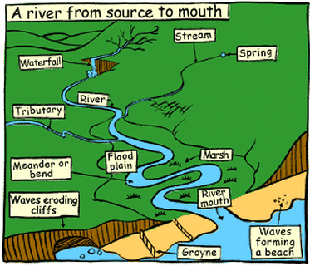
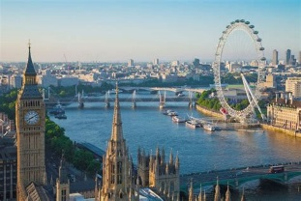
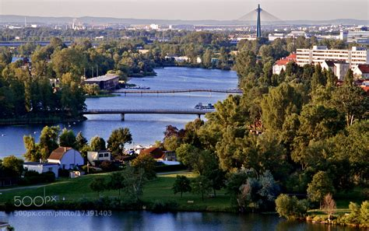
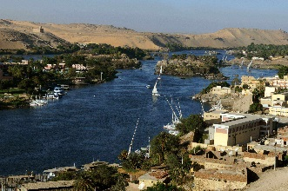
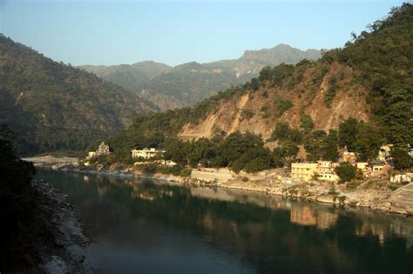
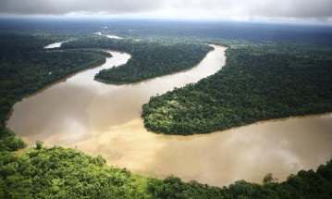
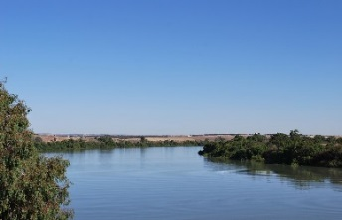
Knowledge Organiser – Year 4 Geography Rivers
Key Vocabulary | Definition
source | The start of the river, usually on high ground.
stream | A narrow river
tributaries | A stream or lots of streams that merge into a river.
estuary | The area where a river meets the sea.
mouth of a river | The end of a river, where the sea begins.
river basin/drainage basin | The area of land from which water has drained into a river.
watershed | The edge of a river basin.
waterway | A route within a river that is used for travel.
River Thames Europe | River Danube Europe | River Nile Africa | The Ganges Asia | The Amazon South America | The Murray Australia

Slide 2

Value Links: Reverence
Respect for all the earth and all its formations
Local Links:
(Fieldwork on Rivers in the South Lakes – TBC)
Lesson Series:
1. What is a river?
2. Rivers of Europe (Reading Text – Rivers and Waterfalls By Elizabeth Miles)
3. Rivers of Africa
4. Rivers of Asia
5. Rivers of Australia, South America and North America
6. Assessment (Extended Write – Compare and contrast 2 rivers)
National Curriculum Coverage:
Use maps, atlases, globes and digital/computer mapping to locate countries and describe features studied
Describe and understand key aspects of:
Physical geography, including: climate zones, biomes and vegetation belts, rivers, mountains, volcanoes and earthquakes, and the water cycle
Year 4
Geography
Rivers
What you need to know:
• Most of the world’s ancient civilisations - ancient Egypt, ancient Mesopotamia, India and China- started near a river.
• Throughout history, rivers have been used for travel and trading, providing a water source for crops, and fresh water for people to bathe in and drink.
• Many of our big cities in the UK are located next to big rivers, like Liverpool on the River Mersey and Newcastle on the River Tyne.
• Rivers change a lot as they carry water all the way down to the sea
• ?Every river begins as a little stream, a starting point called the river’s source. As you follow the river, it will get wider and deeper as it collects more and more water on its way to the sea. As the river draws nearer the sea, it would usually be wide and deep, and the water would be flowing more slowly. By the time the river reaches the sea, it becomes very wide and is called an estuary.
• Several streams called tributaries flow together and jion to make a river.
• The River Thames runs through the centre of London, England. It is the second longest river in England. Other rivers in England include the River Tyne, River Mersey, River Ure, River Avon and River Severn.
• There are many important rivers in Africa. The River Nile is the most well-known river that flows through Africa. It is often debated about whether the River Nile is the longest river in the world in comparison to the Amazon River, South America.
• Asia has many rivers flowing through it, including the River Yangtze, River Yellow, River Ob, Indus and the Ganges. The Yangtze River is the longest river in Asia and is the third longest in the world. It is approximately 3,915 miles long.
• The Amazon River is a well-known river and is often debated to be the longest river in the world, compared with the River Nile. The Amazon is estimated to be about 4000 miles long and flows through seven countries; Guyana, Ecuador, Venezuela, Bolivia, Brazil, Peru and Columbia

