Slide 1
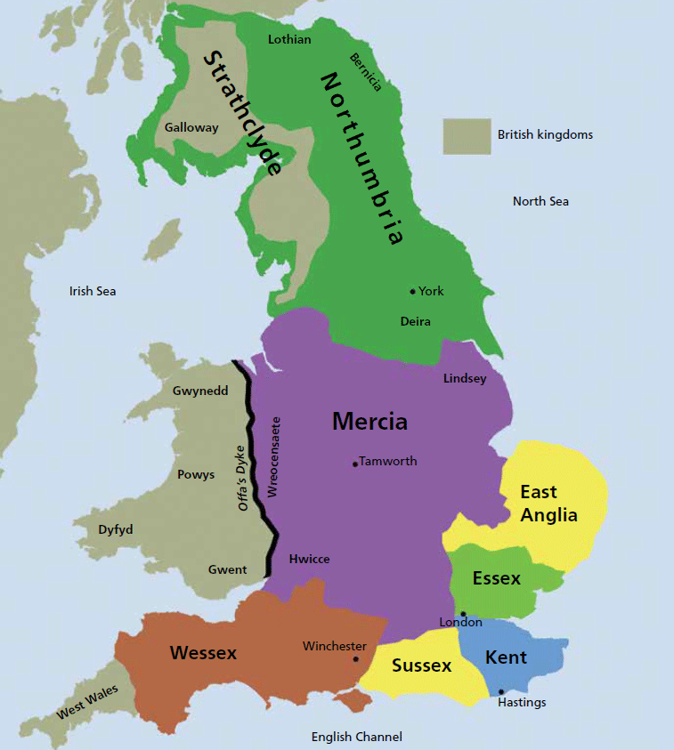
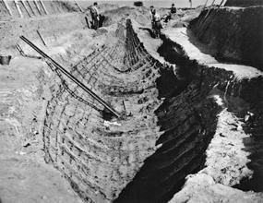
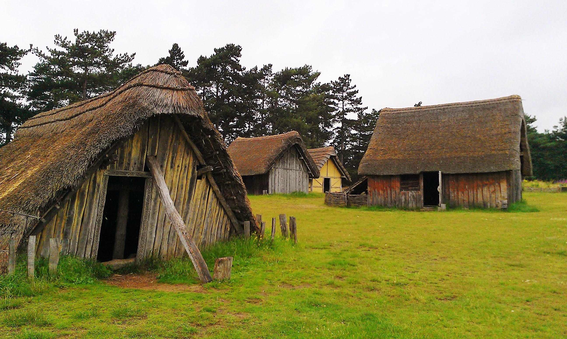
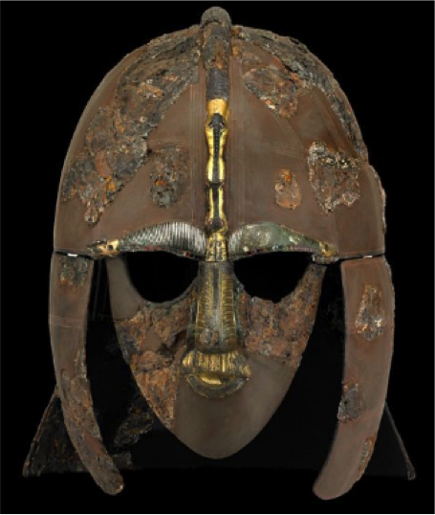
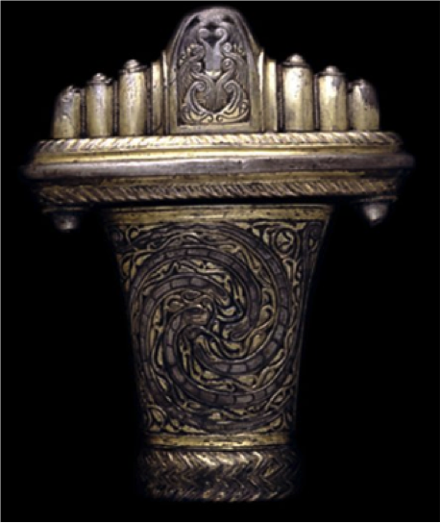
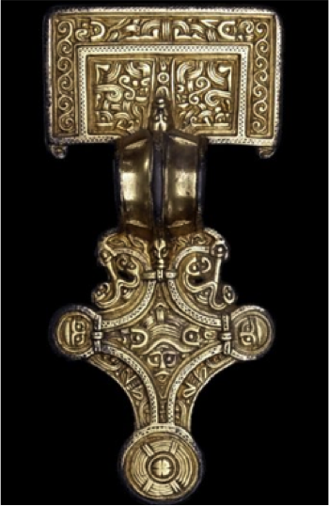
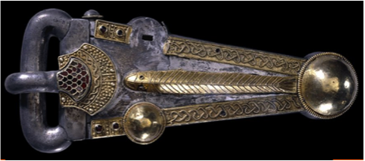
Year 4
Anglo Saxons
Where and What
The 7 Kingdoms | Sutton Hoo | Anglo Saxon Village
Key Vocabulary
Anglo Saxon | People who came from the Germany to live in England during the 5th Century.
Kingdom | A country or place ruled by a King or Queen.
Wessex | An Anglo-Saxon Kingdom in England, once ruled by Alfred the Great.
Mercia | An Anglo-Saxon Kingdom in England, once ruled by a King called Offa who made coins for trading.
Pagan | A word used to describe people who believe in many Gods and Goddesses, often relating to the natural world. During Anglo-Saxon times people believed many different things.
Danegeld | Money, or goods, paid by the Anglo-Saxons to the Vikings to stop them invading more places.
Settlement | A place where people establish a community
Evidence of…
Helmet | Sword | Belt Buckle | Brooch
Protection during invasion | Attacking the Vikings | Clothing | Jewellery
350 AD Anglo Saxons raid English shores and are beaten back by the Romans | 410 AD Romans leave England and English shores are unprotected | 449 AD England is invaded by the Angles and the Saxons | 556 AD Seven Kingdoms are created across Britain | 597 AD St Augustine brings Christianity to Britain from Rome and becomes Archbishop of Canterbury | 871 – 899 AD King Alfred rules Wessex

Slide 2

Year 4
Anglo Saxons
Value Links
Reverence
Religion – Anglo Saxons religious beliefs on Paganism then Christianity
Think like a historian by
Exploring artefacts like a historian
Using historical terms correctly
Asking questions about life in the past
Lesson sequence
Who were the anglo-saxon invaders?
Why did the anglo-saxons want to settle in Britain? (Extended Write – Letter)
What was it like in an Anglo Saxon village?
How was Anglo Saxon Britain ruled? (Reading Text – Beowulf Comprehension)
Who was Alfred the Great?
How did the Anglo Saxons find out about Christianity?
What was the mystery of Sutton Hoo?
Local Links
Anglo Saxon workshop at Liverpool World Museum
National Curriculum coverage
Pupils should be taught about:
Britain’s settlement by Anglo-Saxons and Scots
Key Content
During Anglo-Saxon times, England was split into Kingdoms. The Anglo-Saxons were not a united people, and they ruled each kingdom separately.
The five main Anglo-Saxon kingdoms in England were: Mercia, Northumbria, East Anglia, Wessex and Kent. There was often fighting between the kingdoms.
Many Anglo-Saxons were farmers who owned small areas of land. Anglo-Saxon farmers grew wheat, barley, oats and beans. They would also raise animals.
Before the spread of Christianity, the Anglo-Saxons were pagans and worshipped many gods. They worshipped Gods of the natural world; Gods for family, crops, the weather, love and wisdom. The Pope decided to send a missionary to England to tell all of the pagans about Christianity.
King Alfred ruled the kingdom of Wessex and fought the Vikings bravely. Some of the other Anglo-Saxon leaders joined together with King Alfred to fight against the Vikings.
Key Vocabulary
Anglo Saxon
Kingdom
Alfred the Great
Pagan
Wessex
Mercia
Danegeld
Settlement
Trade

