Slide 1
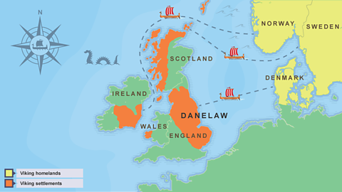
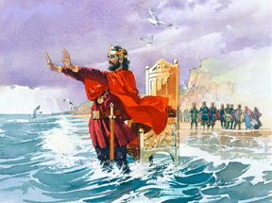
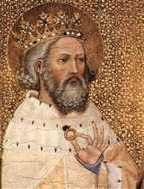
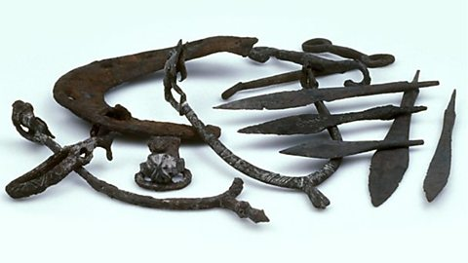
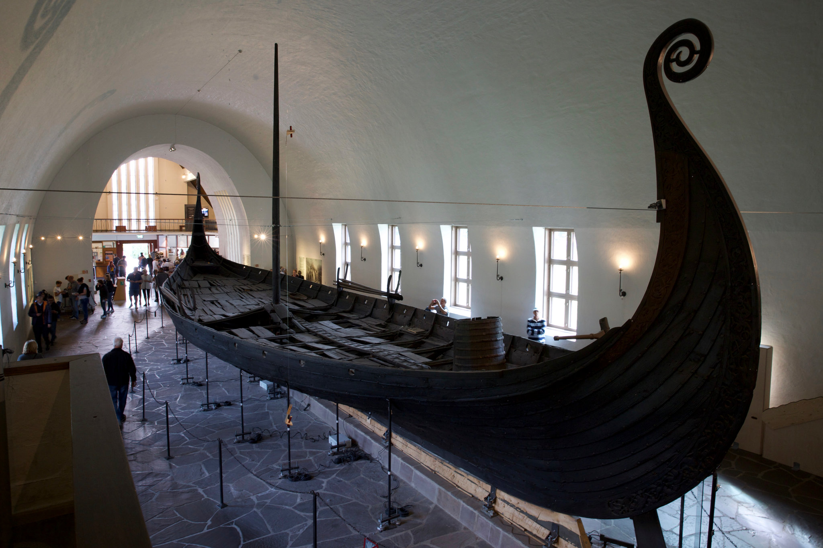
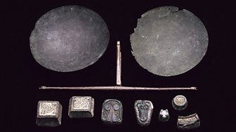
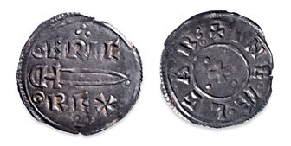
Year 4
Vikings
When and What
Vikings Settlements | King Canute | Edward the Confessor
Key Vocabulary
Viking | People who travelled from Northern Europe to other regions including England. The Vikings raided and traded with other regions.
Raid | An unexpected attack where an enemy comes to steal and/or destroy.
Trade | Buying and selling goods or services.
Invasion | To enter a country or place by force with the intent of taking over.
Danelaw | The area of northern and eastern England ruled by the Vikings.
Danegeld | Money, or goods, paid by the Anglo-Saxons to the Vikings to stop them invading more places.
Evidence of…
Stirrups, Weapon Points and a horse shoe | Long Ship | Balance Scale | Silver Coin
Horse riding and hunting | Travelling to and invading Britain | Weigh coins for trade | ‘Eric Rex’ written on meaning ‘King Eric’
789 AD The Vikings begin their attacks on England | 793 AD Vikings invade Britain | 866 AD Danish Vikings establish a kingdom in York, England. | 886 AD King Alfred defeats the Vikings but allows them to settle in Eastern England (The Danelaw). | 1016 AD – 1035 AD Danish King Canute rules England | 1042 AD – 1066 AD Edward the Confessor becomes King and after his death, leaves no clear successor

Slide 2

Year 4
Vikings
Value Links
Peace – Discuss what we can learn from the Vikings and the importance of having peace
Think like a historian by
Exploring artefacts like a historian
Using historical terms correctly
Asking questions about life in the past
Lesson sequence
How did long ships help the Vikings?
How did the Vikings invade Britain? (Extended Write – An account of a Viking invasion)
What do artefacts tell us about the Vikings?
What was life like in a Viking settlement? (Reading text – How to Train your dragon)
Who were King Canute and Edward the Confessor?
Assessment
Local Links
Vikings workshop at Liverpool World Museum
National Curriculum coverage
Pupils should be taught about:
The Viking and Anglo Saxon struggle for the Kingdom of England to the time of Edward the Confessor
Key Content
The Vikings came from Scandinavia by sea, travelling in warships called long ships. The Vikings invaded Britain. The Vikings believed in many Gods and Goddesses. Odin was the ruler of all the gods.
The Viking raids were ferocious and bloodthirsty. After filling their boats with valuables and killing people, the Vikings would often burn down any buildings left standing after the raid. Some Vikings decided to conquer parts of Britain and stay for good. They attacked the Anglo-Saxon kingdoms and ruled over Northumbria, East Anglia and Mercia, creating Viking settlements. The Viking part of England became known as the Danelaw and people lived there under Viking rule.
The Vikings grew wheat, oats and barley so they were able to make flour for bread, porridge and ale. Vikings also kept animals on their farms such as pigs, sheep, goats, cows and chickens. The houses that the Vikings built were made from woven sticks covered in mud. The woven sticks were called wattle, and the mud covering is known as daub.
Years later, England was ruled by the Viking, King Cnut (also known as King Canute). He had a large Viking empire that included Norway and Denmark. There is a famous story about King Canute showing his followers the limits of his power by being unable to hold back the tides. A few years after the death of King Canute, England had an English King called Edward. He was given the name Edward the Confessor.
Key Vocabulary
Viking
Raid
Trade
Invasion
Danelaw
Danegeld
Defeat
Battle
Capture
Kingdom

