Slide 1

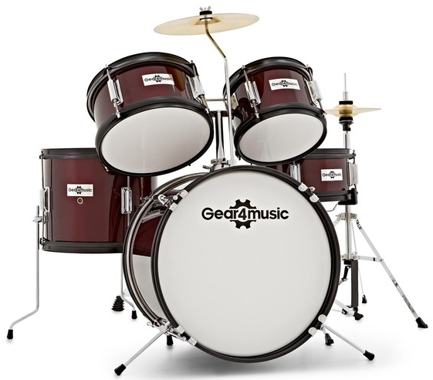
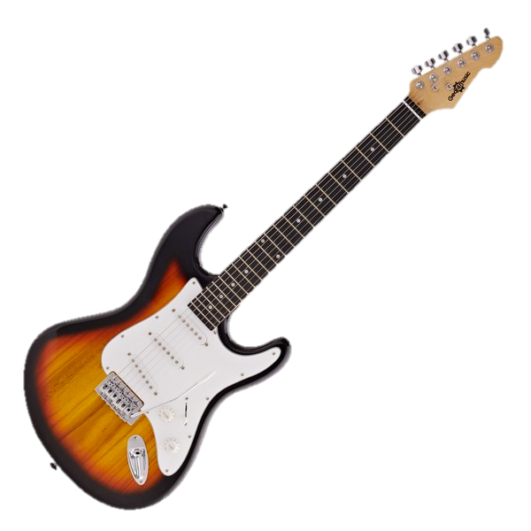
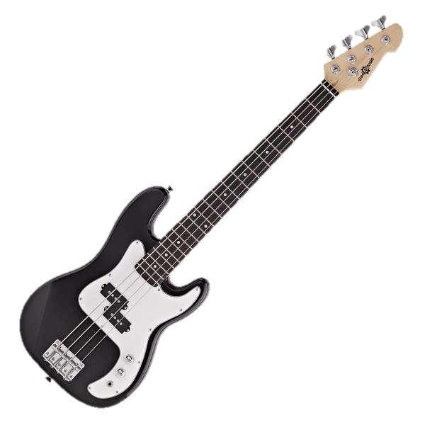
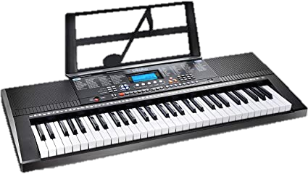
Year 4
Music
Autumn Term
Key Vocabulary
Improvise | To make up a tune and play it on the spot
Compose | Create and develop musical ideas
Melody | Another name for a tune
Dynamics | How loud or quit the music is
Structure | How sections of the song are ordered to make the whole piece
Hook | A short catchy phrase from a song we remember
Riff | A short repeated phrase
Unit Title | Mamma Mia
Unit Theme | ABBA’s Music
Style of Music | Pop
Supporting Songs | Dancing Queen by ABBA The Winner Takes It All by ABBA Waterloo by ABBA Super Trouper by ABBA Thank You For the Music by ABBA
Drums
Electric Guitar
Bass Guitar
Keyboard

Slide 2
4.5 hours
(45 minutes per lesson)
Lesson 1
Listen to Mamma Mia song and answer questions using correct musical language
Vocal warm up and learn to sing the song
Perform the song in groups
Lesson 2
Listen to Dancing Queen song, compare melody to Mamma Mia
Use instruments to play the song
Perform song with singing and instruments
Lesson 3
Listen to Waterloo song, find pules and answer questions about dynamics
Sing, Play and copy back sections of the song
Improvisation activities
Lesson 4
Revisit playing the song with instruments
Learn composition for the song Perform new compositions
Lesson 5
Listen to Super Trouper song, discuss hook and riffs, compare to previous ABBA songs
Continue to work on composition activity
Lesson 6
Listen to Thank You for the Music, identify structure, hooks, riff and dynamics throughout song
Create improvisation with new song

