Slide 1

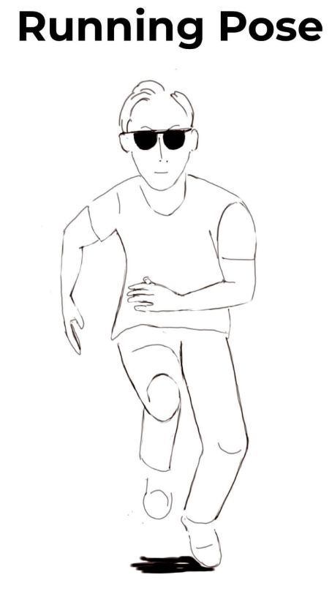
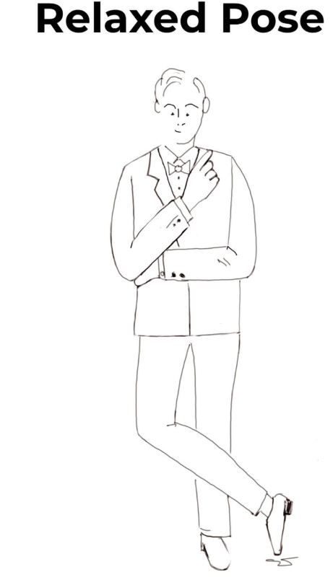
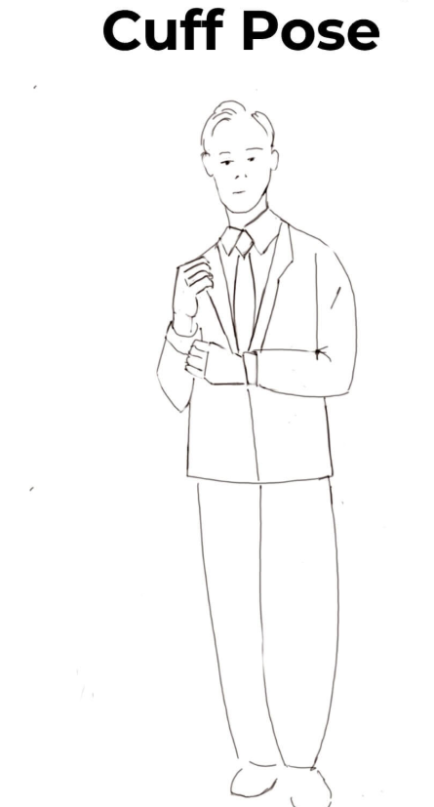
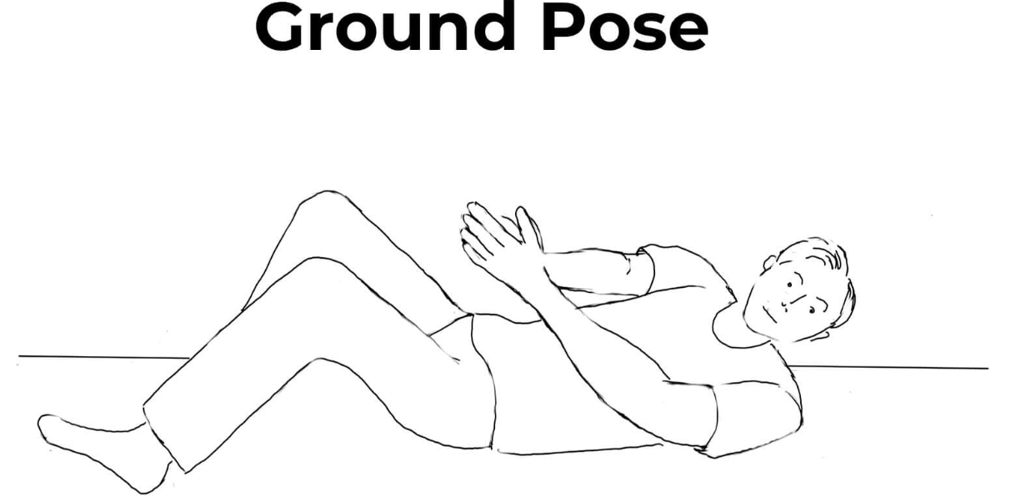
Year 4 Dance Unit 1
Key Vocabulary
Rhythm | To move in a strong, regular pattern.
Direction | To move as instructed
Huddle | To crowd together, nestle closely.
Expression | To convey a feeling or emotion facially or through movement.
Improvisation | To create a dance piece without preparation.
Rehearse | To practise for a later performance.
Director | A person who is in charge of an activity and supervises others in a production.
Freeze frame | To stop the movement and become motionless.
Unit Focus:
Work to include freeze frames in routines
Practise and perform a variety of different formations in dance
Develop a dance to perform as a group with a set starting position

Slide 2
6 hours
Lesson 1
Develop dance ‘freeze frames’ based on a visual stimulus
Work in small groups to create freeze-frame positions
Lesson 2
Develop freeze frame positions to include transitions
Demonstrate how to link positions in a variety of ways
Practice and perform a slide and roll
Lesson 3
Learn and replicate a set phrase
Develop a short dance using unison and formations
Describe different formations
Lesson 4
To perform in cannon routines and cannon lines
Improve and extend mission set phrase
Lesson 5
movements in a logical order
Work collaboratively in small groups to refine movements
Evaluate my work
Lesson 6
Create a 5 action routine following the theme
Practice and perform a routine which includes an ‘entering’ start position
English / Maths Links:
Literacy : Describe the role of—director and choreographer.
Numeracy : Work on counting together as a group to ensure timing especially when performing in cannon and set formations

