Slide 1

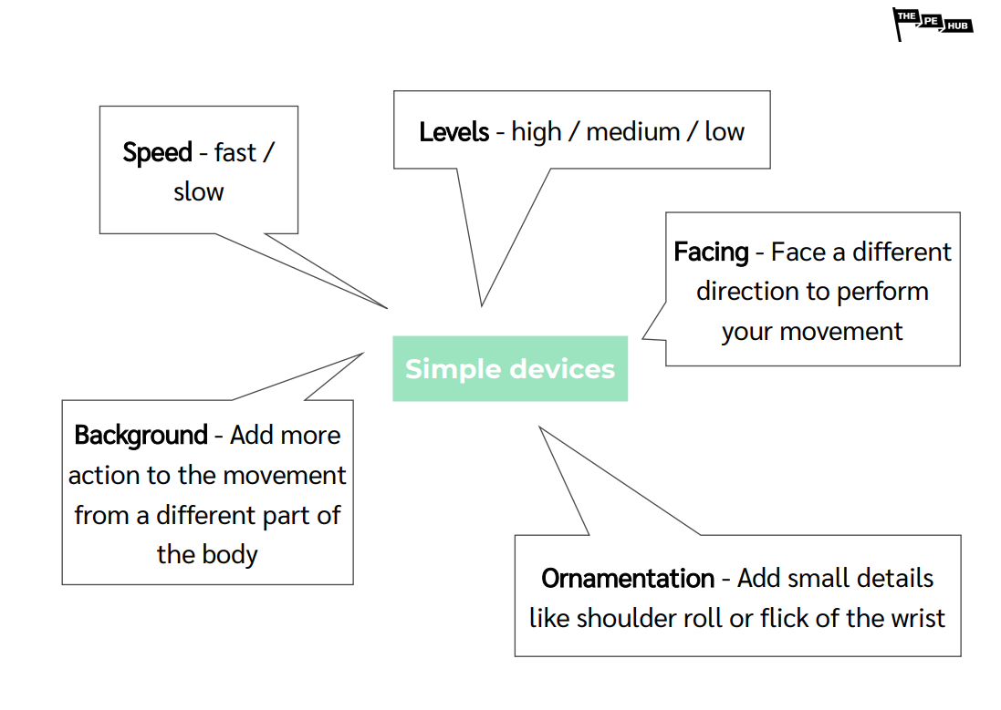
Year 4
Dance Unit 2
Unit focus :
Key Vocabulary
Communicate | To share or exchange information or ideas
Dynamics | To express the way in which shape of movement can be explored.
Floor pattern | To use pathways as you move through the air or around the floor.
Formation | To move in a group to form a certain arrangement.
Speed | To vary the speed of movement
Ornamentation | To use bodily expression to execute the shape of a movement.
Direction | To make different pathways and patterns to move across the floor.
Character | To interpret a certain style of dancing.
Developing choreography and devising skills in relation to a theme
Exploring dynamic quality and formations to communicate character
Concentrating on one simple theme throughout and linking all activities to the communication of this to an audience

Slide 2
6 hours
Lesson 1
Watch professional work and describe how the action communicates the theme
Watch and copy/perform specific dance actions to communicate the theme
Create dance actions which communicate the theme using prompts
Lesson 2
Perform movements with specific dynamic qualities to give them meaning
Create movement in specific dynamic qualities to tell a story
Recognise and apply formations to group work to help communicate the story
Lesson 3
Copy and rehearse travelling movements across space and perform with control
Create travelling movements with floor patterns which help to tell a story
Perform with the music, in front of peers without prompts
Lesson 4
Copy and perform actions which communicate the way a snake moves
Manipulate and develop given action using devices
Manipulate and develop own action using devices
Lesson 5
Work with others sensibly as part of a team
Stay in contact with others to create large movements
Stay focused and perform contact work with others
Lesson 6
Refine dance material for performance
Identify strengths and areas for improvement in other groups’ choreography
Apply feedback from others to improve performance
English / Maths Links:
Literacy : Verbal description and applying a written story to dance
Numeracy : Exploring and using shape and pattern

