Slide 1

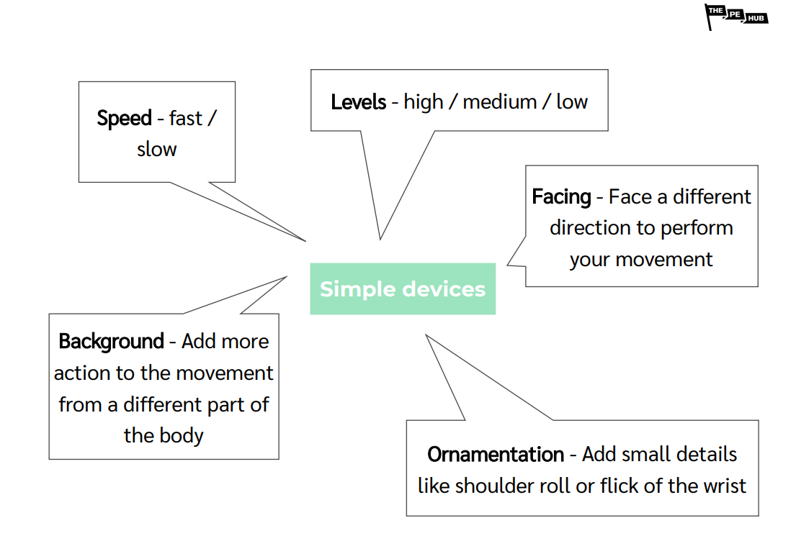
Year 4
Gymnastics Unit 1
Unit focus:
To become increasingly competent and confident to perform skills more consistently
Able to perform in time with a partner and group
Use compositional ideas in sequences such as changes in height, speed and direction
Key Vocabulary
Fluency | To move in a smooth way without seeming to make an effort.
Contrasting | Making different shapes, actions including partner assisted shapes.
Full turn | To make a 360 degree turn on one foot.
Half turn | To move the body 180 degrees to face the other direction.
Sustained | To maintain the body position.
Explosive | To move in a short, sharp movement.
Control | To demonstrate strength and balance.
Combinations | To perform a sequence of movements and balances.

Slide 2
6 hours
Lesson 1
Compose and perform a sequence of 6 elements
Use compositional ideas including changes in speed & direction
Teach your sequence to a partner
Lesson 2
Work with a partner to create a sequence in unison
The sequence should be taught to and combined with another pair to make a four-person sequence
Lesson 3
Compose a sequence of actions including some element of weight on hands
Demonstrate control & body tension when taking weight on hands
Lesson 4
Work in groups of 4 to compose a 6 element sequence
Each member of the group select and plan a compositional component to change the sequence, e.g. levels, matching, speed
Lesson 5
Each member of the group implement a compositional component to change the sequence, e.g. levels, matching, speed
Refine and perform as a group a 6 element sequence
Lesson 6
Perform existing sequence to be judged
Act as judges to evaluate a group sequence
Compare and contrast group performances
English / Maths Links:
Literacy: Communicate with partner effectively using appropriate language to develop, design and evaluate work
Numeracy: Include set numbers of moves in combination and individually

