Slide 1

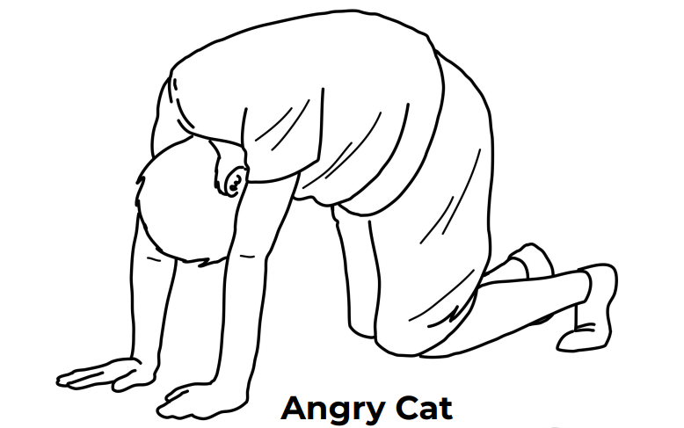
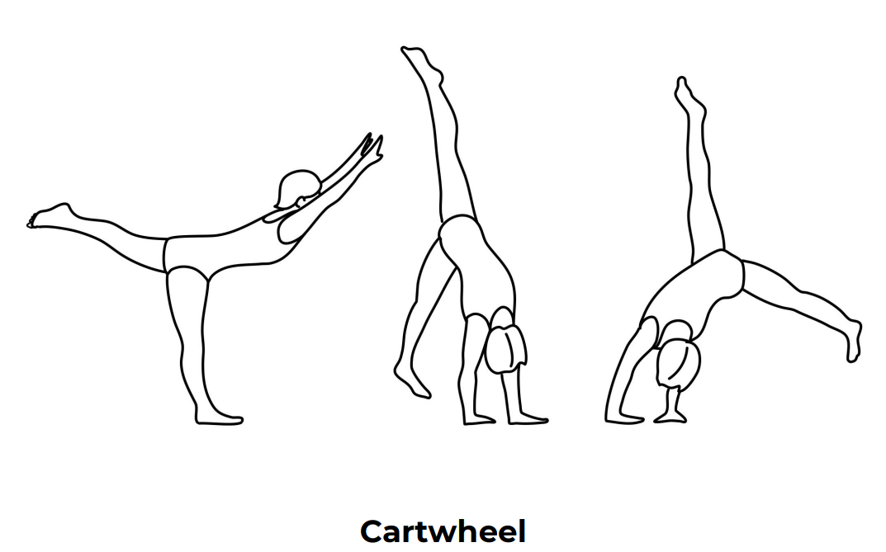
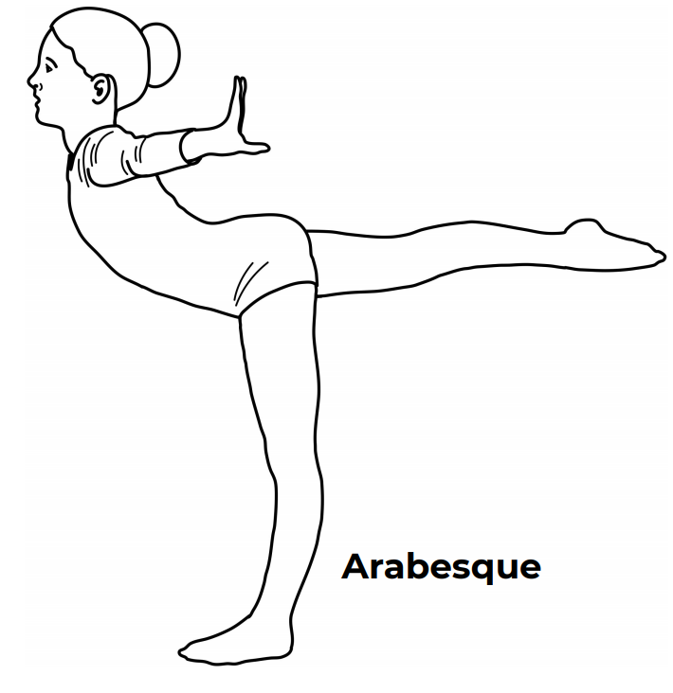
Year 4
Gymnastics Unit 2
Unit Focus : Develop an increased range of body actions and shapes to include in a sequence
Define muscles groups needed to support the core of their body
Refine taking weight on small and large body parts, for example, hand and shoulder
Key Vocabulary
Focus | To produce a clear visual definition
Facial expression | To convey the emotional state of an individual to observers.
Floor pattern | To create movement by using steps.
Formation | The act of giving form or shape in movement.
Ornamentation | To add decorative elements to enhance the performance.
Character | To portray the qualities and personality of an individual.
Speed | To change the rate of movement or action.
Direction | To move to a point from which the person moves or faces.

Slide 2
6 hours
Lesson 1
Watch professional work and describe how the action communicates the theme. Watch and copy/perform specific dance actions to communicate the theme
Create dance actions which communicate the theme using prompts
Lesson 2
Perform movements with specific dynamic qualities to give them meaning
Create movement in specific dynamic qualities to tell a story
Recognise and apply formations to group work to help communicate the story
Lesson 3
Copy and rehearse travelling movements across space and perform with control
Create travelling movements with floor patterns which help to tell a story
Perform with the music, in front of peers without prompts
Lesson 4
Copy and perform actions which communicate the way a snake moves
Manipulate and develop given action using devices
Manipulate and develop own action using devices
Lesson 5
Work with others sensibly as part of a team
Stay in contact with others to create large movements
Stay focused and perform contact work with others
Lesson 6
Refine dance material for performance
Identify strengths and areas for improvement in other groups’ choreography
Apply feedback from others to improve performance
English / Maths Links:
Literacy: Verbal description and applying a written story to dance
Numeracy: Exploring and using shape and pattern

