Slide 1

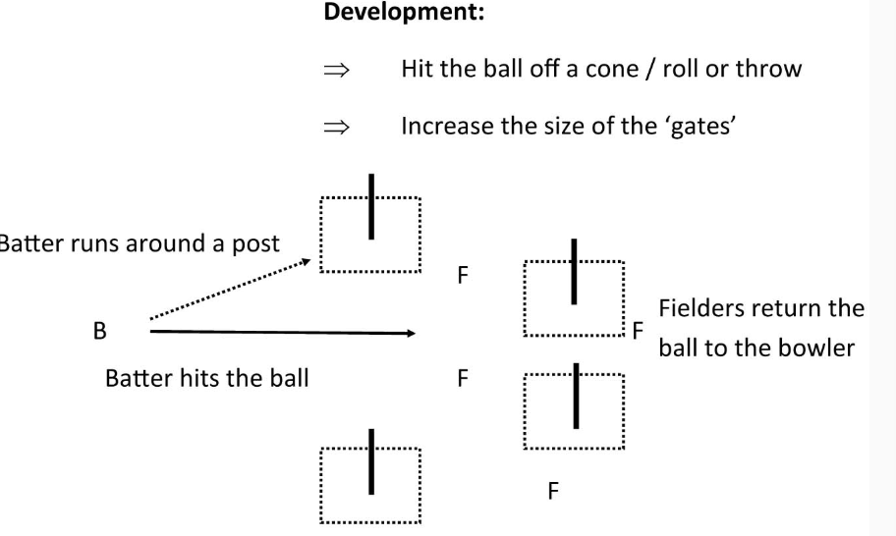
Year 4 Games/Rounders
Unit Focus : I can throw the ball where I want
I can direct my shots into the areas I want
I can keep count of my score
Key Vocabulary
Extensions | To add an extra fielder to be a back stop.
Group work | To work together as a team
Challenge | Ask the team to change a rule of the game or ask the team to work out another way to score points.
Development | Hit the ball off a cone/roll or throw or increase the size of the ‘gates’.
Pace | To move yourself or the ball at a constant speed.
Travelling | To move in the correct direction.
Teamwork | To listen to each other’s directions.
Under arm | To use correct throwing positions.

Slide 2
6 hours
Lesson 1
Throw and catch the ball with increasing accuracy
Hit the ball into zones to score points
Work as an individual to keep score
Lesson 2
Anticipate how many zones the batter can run to
Run at speed to avoid being stumped out.
Lesson 3
. Choosing position when fielding to try to stop a ball
Intercept balls to stop runs in game situations
Work with team to return balls in the field
Lesson 4
Attempt to under arm bowl to batters
Use underarm bowl technique in a game situation
Describe the rules of and surrounding underarm bowling
Lesson 5
Show the standing position of a backstop
Make quick decisions about where to throw to backstop
Play in backstop role in a small game situation
Lesson 6
Identify and describe successful play
Play in a game using rounders scoring system
Describe how to score a full rounder and how to score a half rounder.
English / Maths Links:
Literacy: Explaining what areas are best to hit the ball and why
Numeracy: Keeping count of their scores and others

