Slide 1

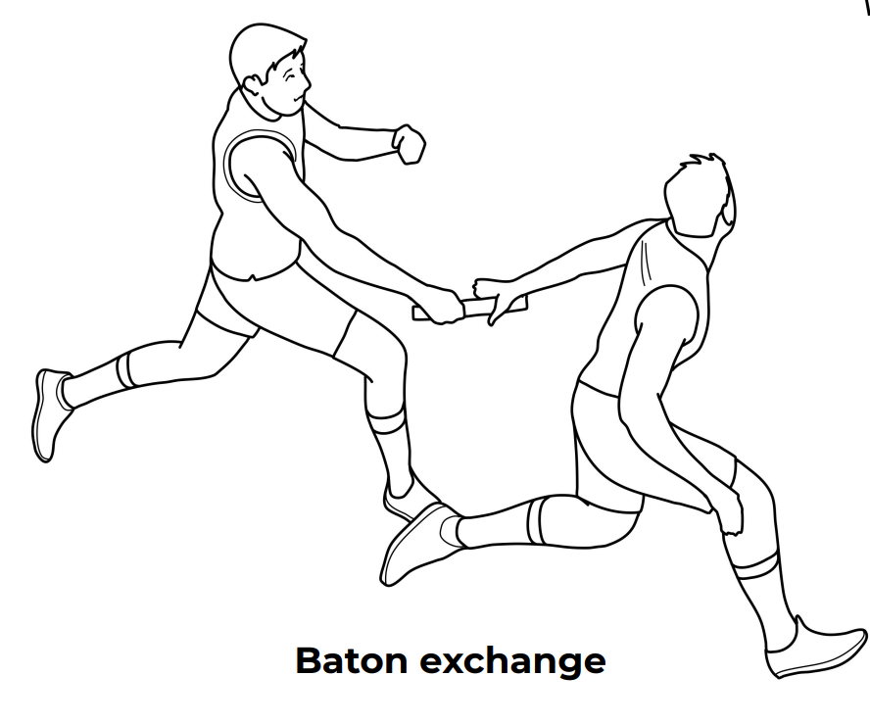
Year 4 Athletics/ OAA
Key Vocabulary
Underarm | To throw with the hand or arm below shoulder level.
Overarm | To throw with the hand or arm above shoulder level.
Roll | To move an object by turning it over.
Push | To push the baton into the partners arm.
Technique | To develop an efficient way of doing something.
Baton | A short stick or tube passed from runner to runner.
Target | A mark or point at which ones fires or aims.
Posture | To position your body when standing or sitting.
Unit Focus: Baton passing, discus throw, and running on curved tracks

Slide 2
6 hours
Lesson 1
Challenge yourself to jump in a variety of ways for distance and height
Show different ways of running
Compare different throws with different equipment
Lesson 2
Assess what fast running feels like
Practice and perform running at speed
Compete over shorts distances against self and others
Lesson 3
Use running to increase the distance of jumps
Judge speed to take off a specified point
Demonstrate control upon take off
Lesson 4
Introduce sling technique for discus throws
Practice wind up technique
Practice with different equipment
Lesson 5
Perform running on a curve
Perform a baton exchange
Analyse as a team how to improve the baton exchange
Lesson 6
Work together in small teams to score points on running, jumping and throwing activities
Challenge self to improve scores using appropriate techniques
Evaluate to aim to improve performance second time
English / Maths Links:
Literacy: Communicate with others to give constructive feedback Numeracy: Measure and total scores achieved in the competition

