Slide 1

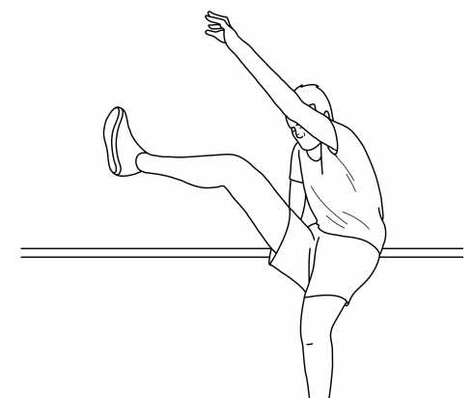
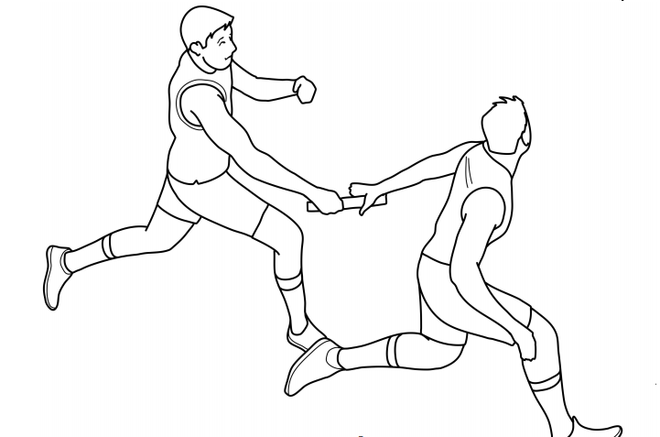
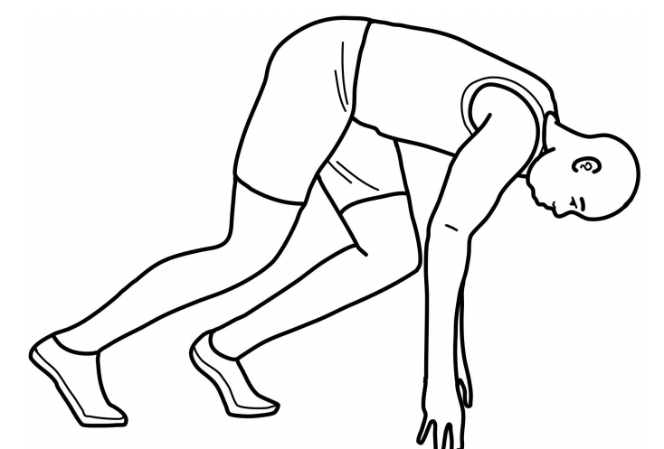
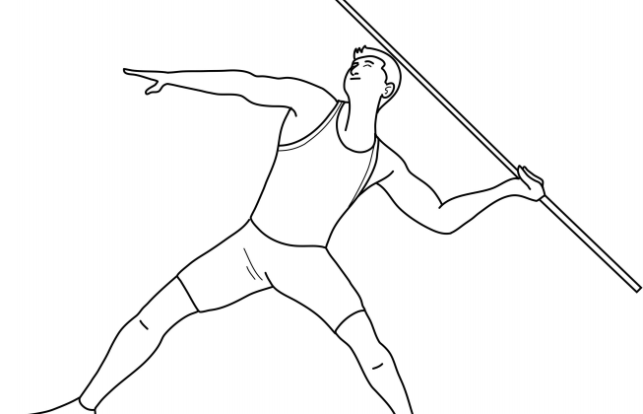
Year 3
Athletics
Unit focus:
To be able to control movements and body actions to specific instructions
To be able to demonstrate agility and speed
To be able to jump for height and distance with control and balance
To be able to throw with speed and power and apply appropriate force
Key Vocabulary
run | to move at speed faster than a walk
jump | to push of a surface and into the air using muscles in the legs and feet
agility | the ability to move quickly and easily
accelerate | to increase your speed and begin to move more quickly
power | to be able to move with great force
speed | the rate in which something moves
hurdles | a series of upright frames over which athletes in a race must jump
foam javelins | a light foam spear used to throw in a competition
sprint start
javelin throw
scissor jump
baton exchange

Slide 2
6 hours
Lesson 1
Can I take off combination jumps?
Lesson 2
Can I run at different speeds with pace and control?
Lesson 3
Can I jump over hurdles with control and balance?
Lesson 4
Can I throw a javelin for distance and accuracy?
Lesson 5
Can I practice a variety of skipping techniques?
Lesson 6
Can I work in a team to participate in running, jumping and throwing activities?
Cross curricular links:
English: Describe how different athletics skills are used in different events.
Maths: Sequence running and jumping for effective distance.

