Slide 1

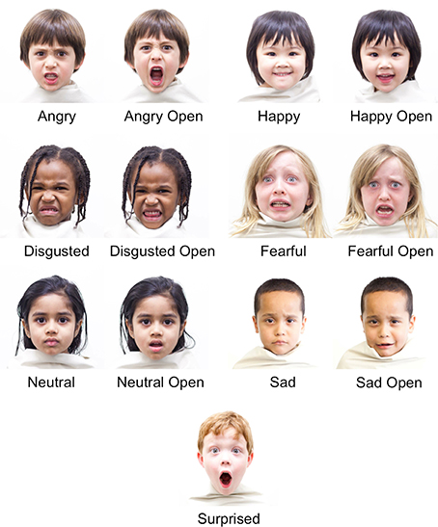
Year 3
Dance (Unit 1)
Unit focus:
Practise different sections of a dance aiming to put together a performance
Perform using facial expressions
Perform with a prop
Key Vocabulary
twist | To form into a bent, curved or distorted shape
turn | To move in a circular motion wholly or partly around an axis or point
step | A part in the dance sequence
rhythm | A strong, regular and repeated pattern of sound
facial expression | To convey different types of emotions without talking
music | Instrumental sounds to convey harmony, expression and emotion
rehearse | To practice a dance routine before a public performance
improvisation | A dance created spontaneously or without any preparation
Facial expressions

Slide 2
6 hours
Lesson 1
Can I select and apply actions to a dance phrase?
Lesson 2
Can I perform as two contrasting characters?
Lesson 3
Can I develop movements using improvisation?
Lesson 4
Can I use a prop?
Lesson 5
Can I use facial expression in my performance?
Lesson 6
Can I become a director and make decisions about how to improve a performance?
Cross curricular links:
English: Describe the different features used in the final performance (i.e. facial expressions)
Maths: Count to music to ensure dancing at appropriate times.

