Slide 1

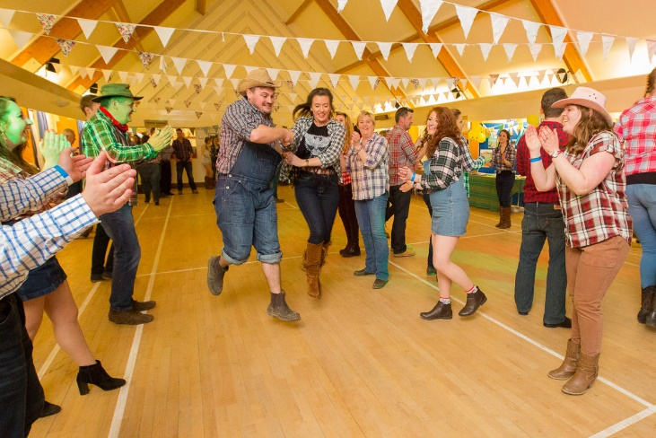
Year 3
Dance (Unit 2)
Unit focus:
Building stylistic qualities of Barn Dance through repetition and applying movement to own bodies
Building basic creative choreography skills in travelling, dynamics and partner work in the specific style of Barn Dance.
Key Vocabulary
Do se do | a figure in which two dancers pass round each other back to back and return to their original positions
Hop step ball change | a dance move that consists of two steps: a partial weight transfer on the ball of a foot (placed e.g., behind), followed by a step on the other foot
Partner work | working effectively with a partner to perform a dance routine
Energetic | A performance involving great energy
Mirroring | Performing the same movements and steps as your partner, at the same time
Linear | Moving in a straight line

Slide 2
6 hours
Lesson 1
Can I do se do, heel dig gallop and split tuck jump?
Lesson 2
Can I explore different ways of travelling and follow floor patterns?
Lesson 3
Can I create some dynamic dance movements?
Lesson 4
Can I create Barn Dance style actions?
Lesson 5
Can I create actions with a partner?
Lesson 6
Can I identify strengths and areas for improvement in others’ work?
Cross curricular links:
English: Describing dance movement. Communicating verbally to describe and visualise an observation. Give feedback to another person/partner/group.
Maths: Working closely with rhythm and refining dance material in terms of line and shape.

