Slide 1

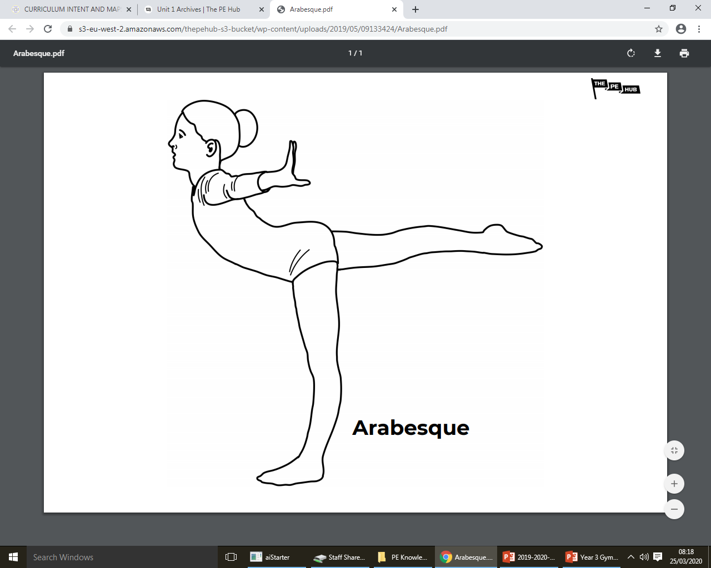
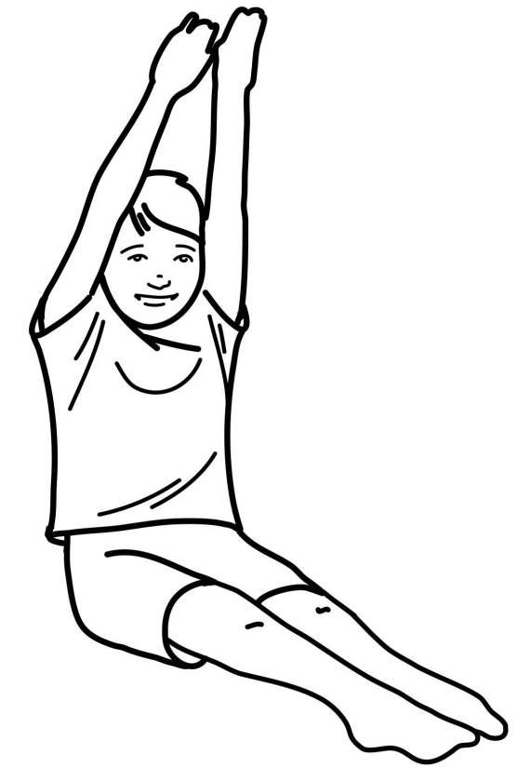
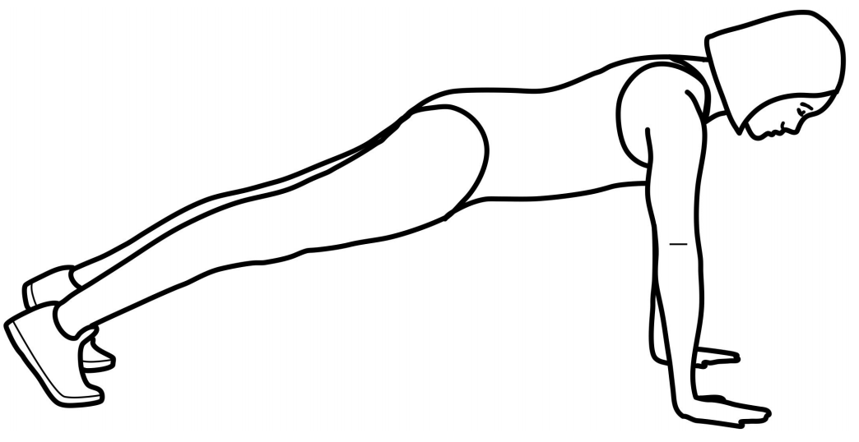
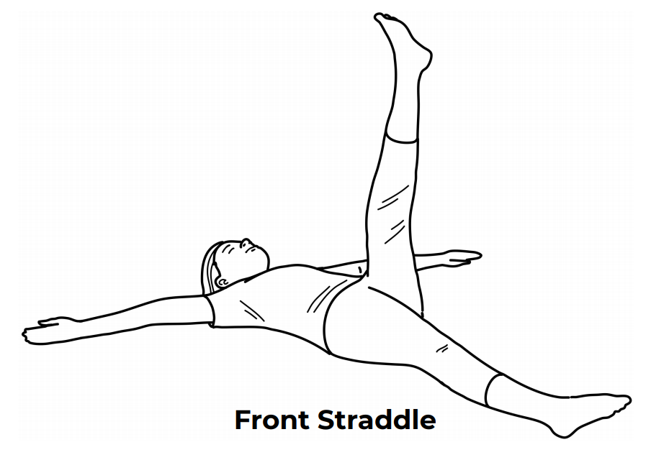
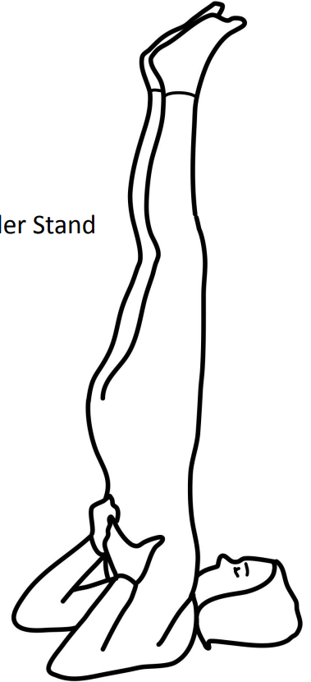
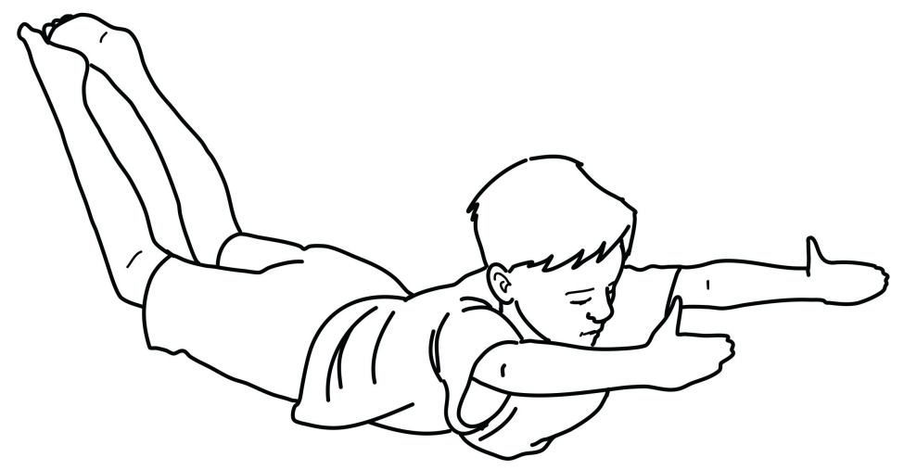
Year 3
Gymnastics
Unit focus:
Modify actions independently using different pathways, directions and shapes
Consolidate and improve the quality of movements and gymnastics actions
Relate strength and flexibility to the actions and movements they are performing
To use basic compositional ideas to improve sequence work—unison
Key Vocabulary
fluency | To be able to use different parts of the body smoothly and effectively
contrasting | Performing completely unrelated movements and shapes
low | Getting into a low position, close to the ground
unison | Performing with a partner with the exact same movements at the exact same time
balance | An even disruption of weight enabling someone to remain upright and steady
explosive | A sudden or dramatic movement
power | To move or travel at great speed or force
arabesque
front support
pike
arch
shoulder stand
front straddle

Slide 2
6 hours
Lesson 1
Can I extend into a full range of balances and shapes?
Lesson 2
Can I move in and out of a range of contrasting shapes fluently?
Lesson 3
Can control my body and strength when moving?
Lesson 4
Can I jump for height and distance?
Lesson 5
Can I work in unison with my partner?
Lesson 6
Can I start and finish patterns as a group?
Cross curricular links:
English: Using appropriate language to help improve the performance of individual actions and group sequences.
Maths: Able to estimate how long it will take to complete a sequence; time movements to correspond with others.

