Slide 1

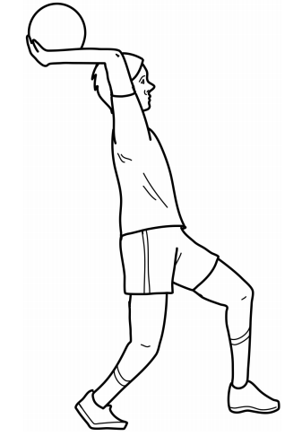
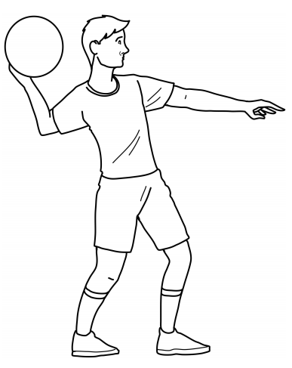
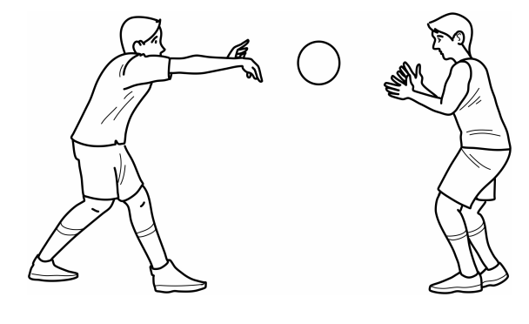
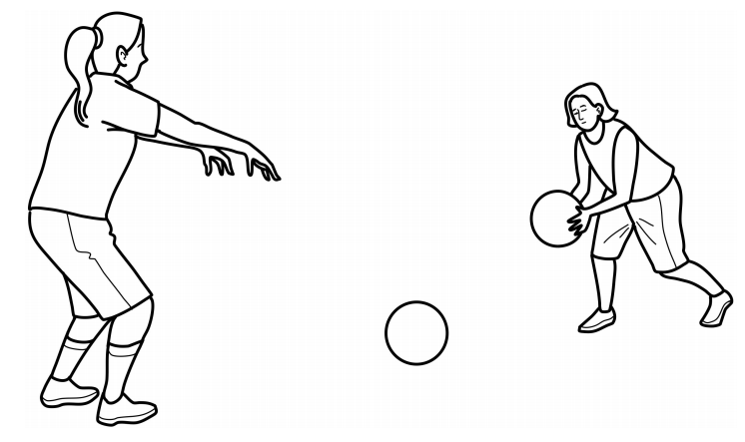
Year 3
Netball
Unit focus:
To be able to perform basic netball skills such as passing and catching using recognised throws
To use space efficiently to build attacking play
To implement the basic rules of netball
Key Vocabulary
pass | a way of getting the ball from one player to another player
marking | used to prevent the opposing team from gaining possession of the ball by closely monitoring each player
dodge | a way of moving quickly to avoid another player
defend | players defend their players to keep possession of the ball.
possession | having control of the ball
intercept | to take possession of the ball during an attempted pass by the opposing team
overhead throw
bounce pass
chest pass
shoulder pass

Slide 2
6 hours
Lesson 1
Can I use the chest pass?
Lesson 2
Can I use dodging skills to trick my opponent?
Lesson 3
Can I create and understand the importance of space?
Lesson 4
Can I use the bounce pass?
Lesson 5
Can I use the shoulder pass to throw for distance?
Lesson 6
Can I maintain possession of the ball?
Cross curricular links:
English: Using appropriate language for netball and games: passing, catching, and use descriptive language to help improve the performance of skills and tactics.
Maths: To estimate the speed and distance of run and pass. Able to explain and apply the 3 second rule.

