Slide 1

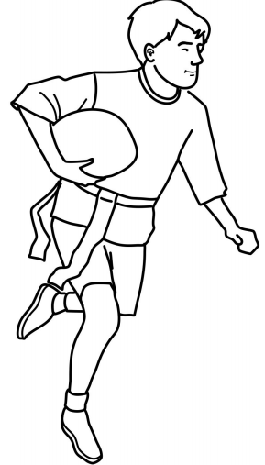
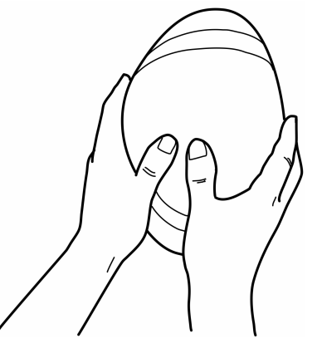
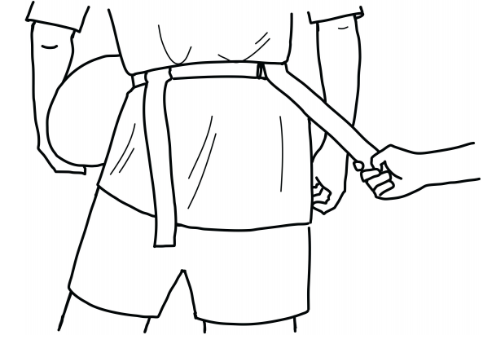
Year 3
Tag Rugby
Unit focus:
To be able to handle a rugby ball with confidence
Evade attackers using footwork and body control
Link skills to perform as a team in attack
Use basic game principles of tag rugby and play within simpler rules
Key Vocabulary
pass | a way of getting the ball from one player to another player
marking | used to prevent the opposing team from gaining possession of the ball by closely monitoring each player
attacker | an attacker’s role is to maintain possession of the ball and score
defender | a defender’s main jobs are marking and tagging
tag | players must always have two tags on their belt whilst playing the game. Only the person with the ball can be tagged
sidestep | involves a quick change in direction and can be used to get around an opponent or avoid being tackled
dodging | involves a quick change of direction to try and send the defender the wrong way
Passing back | in rugby the ball is not allowed to be passed forward. Only sideways or backwards passes are allowed.
‘W’ grip
belt position
running with the ball

Slide 2
6 hours
Lesson 1
Can I run past defenders?
Lesson 2
Can I handle the ball correctly?
Lesson 3
Can I evade players and move into a space?
Lesson 4
Can I pass the ball once I have been tagged?
Lesson 5
Can I track and close down the attackers?
Lesson 6
Can I pass backwards?
Cross curricular links:
English: Using appropriate language for invasion games: passing, catching, evasion, and use descriptive language to help improve the performance of skills and tactics.
Maths: To estimate speed and distance of run and pass. Able to explain passing backwards.

