Slide 1

Welcome to
Year 2
Mrs Morrell
Mrs Lonsdale
Notes:
Replace these sample pictures with cute ones of your own. It’s easy to do: Select the sample picture and delete it. Now click the Insert Pictures icon inside the frame, and locate the picture you want display.

Slide 2
Welcome to Year 2
We hope that your child has settled in well to Year 2.
We have certainly enjoyed teaching them so far and they are all impressing us with their smiley faces and enthusiasm.
Hopefully, this pack will answer any questions you might have about Year 2.

Slide 3
Our Vision Statement
At Holy Trinity Church of England Primary School, every child is recognised as a unique individual. We celebrate and welcome differences within our diverse school community, encouraging all to grow and flourish as precious children of God. Learning is centred around experiencing the joy of discovery. The ability to learn is underpinned by the teaching of basic skills, knowledge, concepts and values, with a vision to prepare our children to be life-long learners, rooted in our school motto: To be the best we can be: For God, for others and for ourselves.

Slide 4
Holy Trinity Church of England Primary School
Our school motto is:
To be the best you can be: for God, for others and for our ourselves

Slide 5
Values
Our Christian Values are:
Love
Hope
Forgiveness
Trust
Peace
Reverence
Justice

Slide 6
Staffing
Mrs Morrell is the class teacher in Year 2.
Mrs Lonsdale is our Teaching Assistant.
Mrs Lonsdale & Mrs Rees will teach the class every Thursday afternoon for PPA.
Miss Daniels will teach the class on a Tuesday afternoon for management time.

Slide 7
Our School Day
Gates open 8.40am
Children taken into class at 8.50am
Gates close at 9am
School finishes at 3.20pm
Please inform school if:
~ you are going to be late (if possible!)
~ if your child is being collected by another adult
~ if your child is ill (before 9.15am)

Slide 8
Attendance Matters
At Holy Trinity Church of England Primary School, we aim to encourage and assist all pupils to achieve excellent levels of attendance and punctuality.
Our target for all pupils is to achieve 97% attendance over the course of a school year, with no unauthorised absences.
We firmly believe that poor school attendance, and/or regular late arrival, breaks the continuity of a child’s learning and limits their academic and social progress in school.

Slide 9
Attendance Matters
Ensuring your child’s regular attendance at school is a parent/carer’s legal responsibility (Section 444 of the 1996 Education Act), and we want to ensure that we are doing all that we can do to support you.

Slide 10
Attendance Matters
Expectations of Parents/Carers:
Ensure your child arrives for school on time
Telephone school if your child is to be late
Contact school by 9.15am on the first day of absence if your child is unable to attend through illness, giving an indication of the expected duration and return date to school
Book holidays/appointments out of school time

Slide 11
Attendance Matters
Expectations of School:
Telephone and text the parent/carer on the first day of absence if we have not heard from you by 9.15am
If no response is received and the absence is unauthorised a member of school staff will conduct a home visit
If a pupil’s absences are increasing and we are not aware of a good reason, the parent/carer will be invited to a meeting
If absences persist the School Learning Mentor and Headteacher will discuss actions with the Education Welfare Officer.

Slide 12
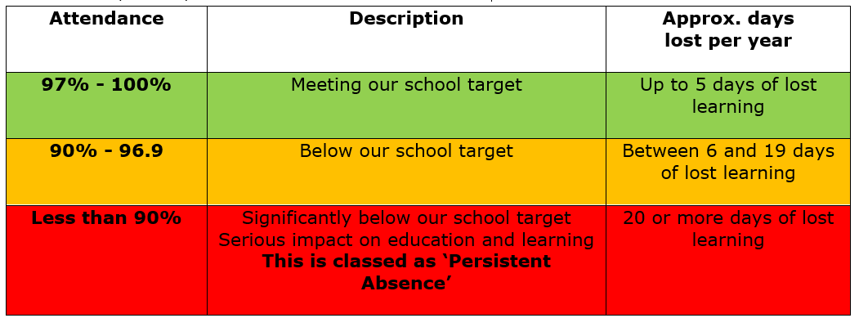
Attendance Matters
We use a Red, Amber, and Green code to rate attendance:

Slide 13
Holidays
The government dictates that holidays during term time will not be authorized unless there are exceptional circumstances
Requests for holidays should be made to Mrs Thompson by completing a Holiday Request Form. You can get these from the office
Sefton are now fining parents/carers for unauthorised absences

Slide 14
School Uniform
Children should always be in the correct school uniform
School shoes should be black
If there is a problem with school shoes, trainers may be worn to school where children can change into their PE pumps
Long hair should be tied back
Jewellery – only stud earrings and watches can be worn
Hair bobbles and headbands should be black or navy blue and should be plain

Slide 15
Equipment
All stationery is provided in school.
Book bag will be provided for Y2 children.
Children should bring water bottle every day.
Dinner - £2.50 per day.
Any inhalers should be named on please and in date. These will be stored in a grab bag by the door to allow for easy access.
Packed lunches will be stored in a trolley outside of the classroom.
Fruit or a healthy snack is allowed at break time.
**Please do not send any snacks containing nuts due to some staff and children allergies**

Slide 16

P.E
P.E days are Monday and Wednesday - Children should come to school dressed in their P.E Kit
Navy blue t-shirt, navy blue shorts and pumps. Trainers may be worn for outdoor P.E
Black / dark coloured jogging bottoms and trainers for outdoors in winter.
No ear-rings for P.E days (tape to be put on if children cannot remove their own).
Hair should be tied back.

Slide 17

Please Label Everything!
Label, label, label!
Please label EVERYTHING that belongs to your child!
Coat
Every
item
of
uniform!
Lunch
Box
P.E
Kit
Water
Bottle

Slide 18

Discovery Curriculum

Slide 19

Discovery Curriculum

Slide 20

Homework
Reading
Spellings
Times Tables

Slide 21
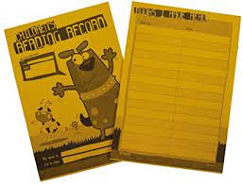
Helping your child with reading
Reading is the passport to the world!
Please try to read with your child at least 3 times per week and the complete reading record
Children will earn a raffle ticket which will be entered into our half termly prize draw
Try to encourage your child to read with fluency, steady pace and expression
Ask what is happening? Predict what is going to happen next? General talk about the book – likes / dislikes / have they been in a similar situation etc
Spot any ‘WOW’ words? Check meaning of words

Slide 22

Helping your child with
Maths
Mental Maths
Times Tables – 2,3,5 and 10
Number bonds to 10 and 20
Money
Telling the time
Times Tables Rockstars – details in reading record

Slide 23
Helping your child with Spellings
Use of Purple Mash in school and at home to support your child.
Each half term spelling lists for each week will be sent home, added to class dojo and on the class webpage.
Weekly spelling test every Friday.

Slide 24
Online Safety
Children are taught about the importance of staying safe online. Please and discuss the Computer Rules with your child.
If you are concerned about any aspect of online safety please don’t hesitate to contact us.

Slide 25

Class Dojo
Class Dojo is now the main method of communication so please check in regularly for updates and news about your child’s class.
If you would like to share any out of school achievements we would love to hear about them so send us a message/photo on Class Dojo.

Slide 26
School Contacts
School Nurse: Our School Nurse is Ms Helen Yates. You can contact her or the other nurses directly at Merseycare on 0151 247 6354 or you can contact the school nurse directly at: mcn-tr.hoghton0-19team@nhs.net or speak to the office.
Alternatively, we commonly hold drop-in sessions at the Parish Centre that you can attend without an appointment.

Slide 27
School Contacts
Family Link Worker: Mrs Louise Rees is our Family Link Worker at Holy Trinity Primary School. One of her roles is to provide practical support to all our families and a chance to chat things through. This might be support with school concerns, housing, employment, benefits, physical health, mental health or many other things. She is available to speak to most mornings on the Infant Yard Gate. Please feel free to pop into school and see her or email Mrs Rees for an appointment: louise.rees@ldst.org.uk

Slide 28
School Contacts
Learning Mentor/Safeguarding Coordinator: Our Learning Mentor is Mrs Jude Rankin and she is available to speak to most mornings and afternoons on the Junior Yard Gate. Mrs Rankin works closely with families that require support and oversees our attendance. If you find yourself struggling or have any issues or concerns, please speak to Mrs Rankin or the school office so that school can support you. You can call on 07970 389 365 or email Judith.Rankin@ldst.org.uk.

Slide 29

School Dinners
Delicious cooked lunch at a cost of £2.50 per day
(Weekly menu available at the school office)
Or
Healthy Lunch box
We have forms to see if you are eligible for Free School Meals. A member of staff will support you to complete the form.

Slide 30

Kids Club Southport
runs from Monday – Friday 3pm-6pm
For more information contact Sue Moir at any time on
07951 540919 for more information

Slide 31
Additional Information
Year 2 children who did not pass the Phonics Screen Check last year will resit this in the week beginning the 12th June 2023.
Year 2 SATs will be administered in May.

Slide 32
Any questions?
We hope that you find the information here useful but if you have any further questions, please don’t hesitate to contact us via Class Dojo or by ringing the office.
Year 2 Staff

