Slide 1


Welcome to
Holy Trinity Church of England Primary School
‘To be the best we can be: for God,
for others and for ourselves’
Here is all the information you are going to need for your child to start school.

Slide 2

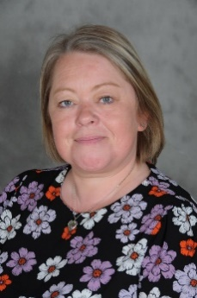
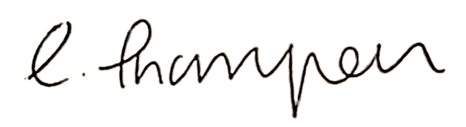
WELCOME LETTER
Holy Trinity Church of England Primary School
Manchester Road, Southport, PR9 9AZ
Tel: 01704 538366 Fax: 01704 548232
www.holytrinityprimary.co.uk E-mail: office@holytrinityprimary.co.uk
To be the best we can be: for God, for others and for ourselves
Headteacher: Mrs Linda Thompson
Dear Parents and Carers,
We are delighted that you and your child have chosen to start their school journey with us at Holy Trinity Church of England Primary School. At Holy Trinity, we are committed to providing a smooth transition into school to allow each child to settle in, get to know the staff and to make new friends. We know that parents and carers play a really important role in this transition so that you too can feel reassured that your child is safe and happy at school. Starting school is a very special time for you and your child and a time when very precious memories are made.
Should you have any questions at all, please do not hesitate to contact us via email at finance@holytrinityprimary.co.uk or telephone on 01704 538366.
We are really looking forward to welcoming you and your child into our Holy Trinity family.
Kind regards,
Headteacher

Slide 3

LIVERPOOL SCHOOLS
DIOCESAN TRUST
Holy Trinity are pleased to be a part of the Liverpool Diocesan Schools Trust (LDST).
What is the LDST?
The LDST is a family of schools. We support and connect with each other, share practice, and provide an excellent education that is built on distinctly Christian values, so that all children, learners and staff across our Trust, flourish. Central to this are our core values of collaboration, difference, local and inclusion, and our commitment to ensuring that all learners thrive through an education that teaches wisdom, instils hope, nurtures community, and embeds dignity and respect.

Slide 4
Holy Trinity is a Church School
As a Church School, Holy Trinity has Christian beliefs and values at our heart. This means that every child and adult associated with our school is not just important because they are members of our school, but also because they are seen as unique individuals within God’s creation. Our motto, ‘To be the best we can be: for God, for others and for ourselves’, is the golden thread which runs through all we do. Church of England schools are places where the questioning of belief and non belief is encouraged as we all try to make sense of the world, the gift of life and the purpose of our own personal lives. We have a rich and diverse community here, where children of all faiths and non, are welcomed.
‘The vision ‘to be the best we can be’ is central to the life of this diverse and vibrant school. Leaders, including governors, articulate the vision’s theological foundations. This motivates them to strive wholeheartedly to enable the whole school community to flourish. ‘ SIAMS, 2023
Our School Vision and Values
At Holy Trinity Church of England Primary School, every child is recognised as a unique individual. We celebrate and welcome differences within our diverse school community, encouraging all to grow and flourish as precious children of God. Learning is centred around experiencing the joy of discovery. The ability to learn is underpinned by the teaching of skills, knowledge, concepts and values, with a vision to prepare our children to be life-long learners, rooted in our school motto: To be the best we can be: For God, for others and for ourselves.
Christian Values
Love | Hope | Forgiveness | Trust | Peace | Reverence | Justice
Collective Worship
Collective Worship is a time set aside daily, where we come together to share our love of God and give opportunities for spiritual, moral, social and cultural exploration. Teachers and families value the special dimension worship brings to church school life. We fully embrace our duties as a church school and our worship themes are based on the teachings of Christ and traditions of the Christian Church. However, we lead our Collective Worship in a manner that is sensitive to the individual faith and beliefs of all members of the school. As a school with children from all over the world, it is very important that we embrace, value and respect all faiths.

Slide 5
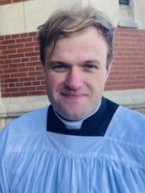
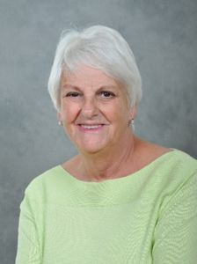
OUR CHURCH FAMILY
OUR CHAIR OF GOVERNORS
Message from our Vicar
Holy Trinity Primary School and Holy Trinity Church are next door to each other, but we are even closer than that! Please look on Holy Trinity Church as yours, whatever your faith. Feel free to come in when it is open and know that I am always very happy to meet the families of the children. I look forward to meeting you soon and to welcoming you into Church for the acts of worship that the school offers through the year.
Fr Tom
Parish Priest
Message from our Chair of Governors!
All Schools in England and Wales have a Board of Governors. Its members are all volunteers appointed in a variety of ways. As a church school we have Governors including the Head and two Parent Governors. To make sure we get the expertise we need we can also appoint two Governors to give us balance of skills and knowledge.
Our responsibility is to ensure that the school has a clear vision,
knows where it is going and uses the finances it has wisely to
provide the very best education for all pupils.
If you have any questions about what we do or would like to
find out about becoming a governor I would be delighted to
hear from you.
Marlyn Banham
Chair of Governors

Slide 6
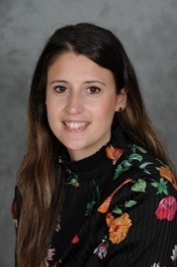
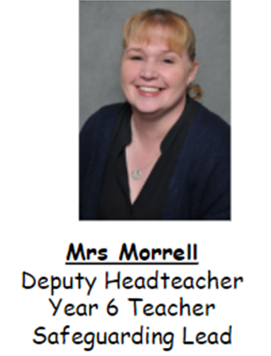
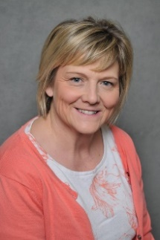
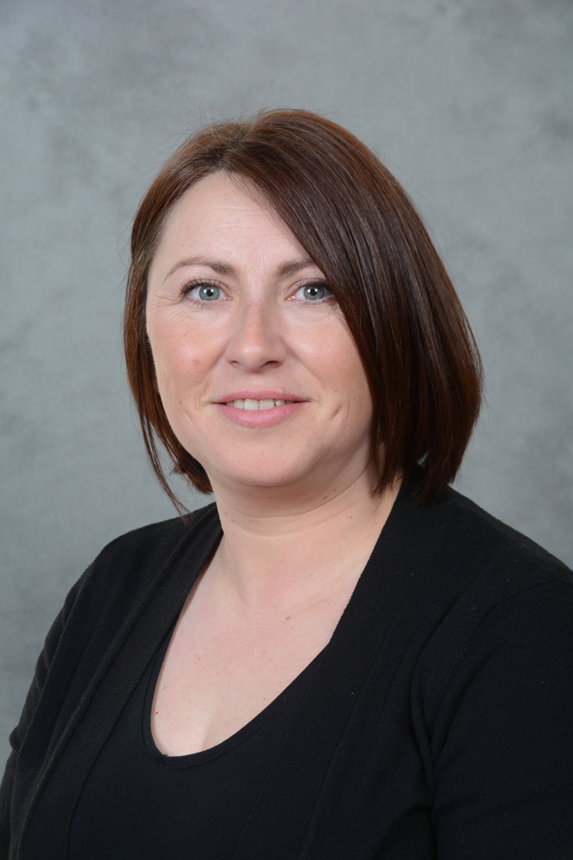
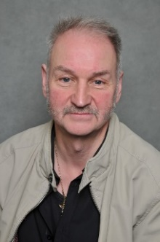
OUR SCHOOL FAMILY
Mrs Thompson
Headteacher
Designated Safeguarding Lead
Miss Daniels
Deputy Headteacher
Class Teacher
Deputy Safeguarding Lead
Mrs Morrell
Senior Leader
Class Teacher
Deputy Safeguarding Lead
Mrs Wood
Office Manager
Mrs Redmond
Office Assistant
Mr Macneil
Caretaker

Slide 7
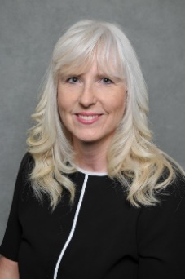
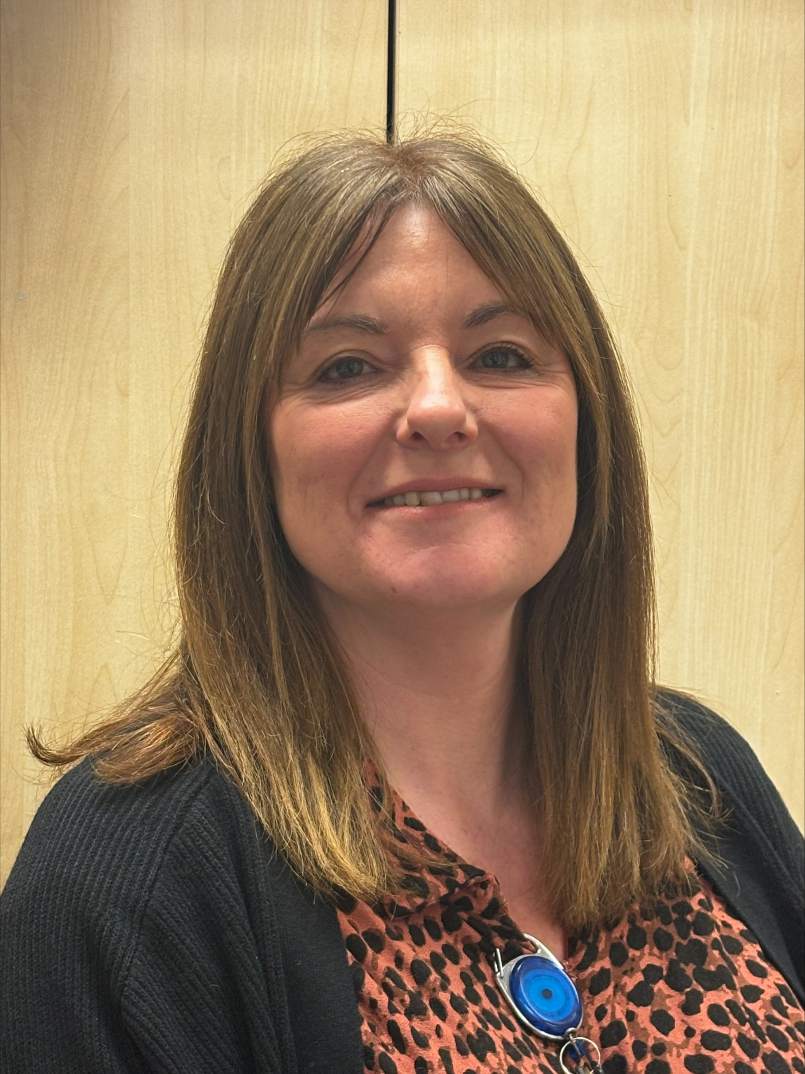
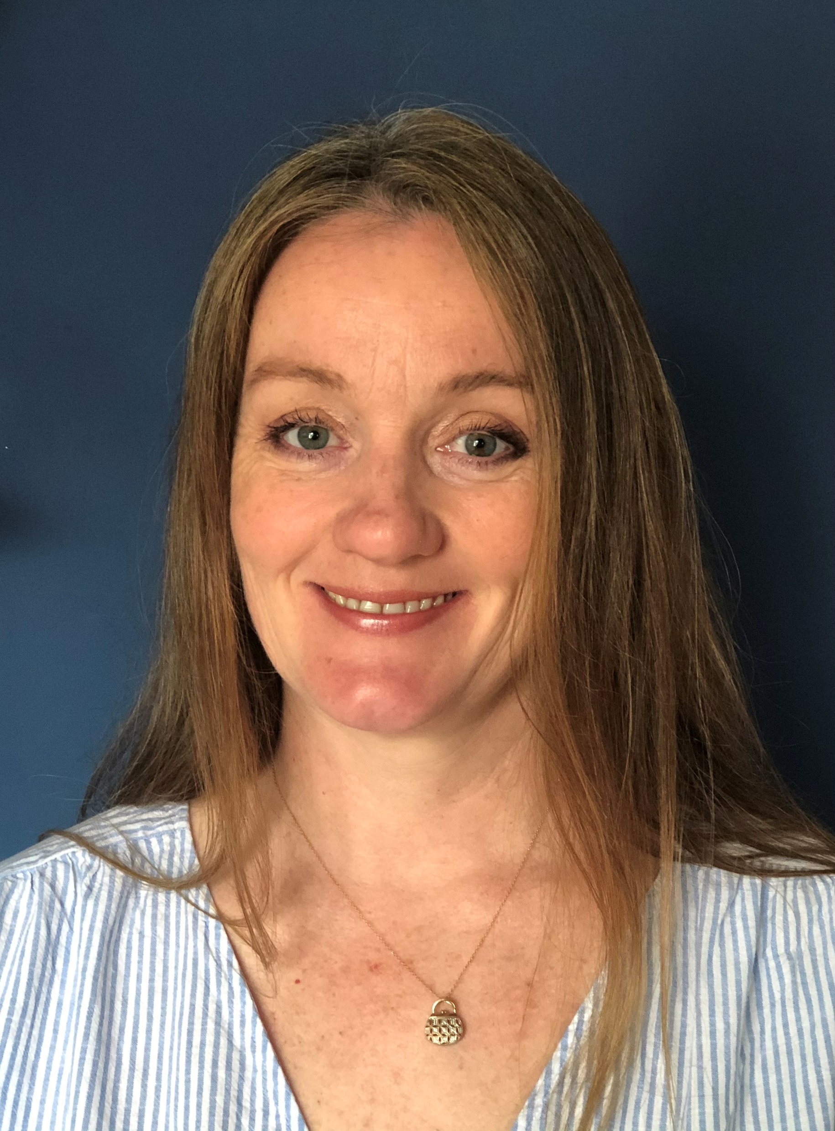
OUR PASTORAL SUPPORT STAFF
Mrs Hannah
Special Needs
Teaching Assistant
Mrs Lincoln
Learning Mentor
Deputy Safeguarding Lead
Mrs Fletcher
SENDCO
Special Educational
Needs Coordinator
Mrs Thompson
Designated Safeguarding Lead
Miss Daniels
Deputy Safeguarding Lead
Mrs Morrell
Deputy Safeguarding Lead
Mrs Fletcher
Deputy Safeguarding Lead

Slide 8
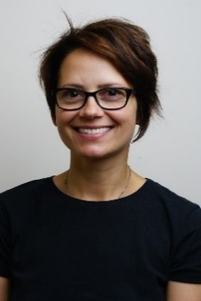
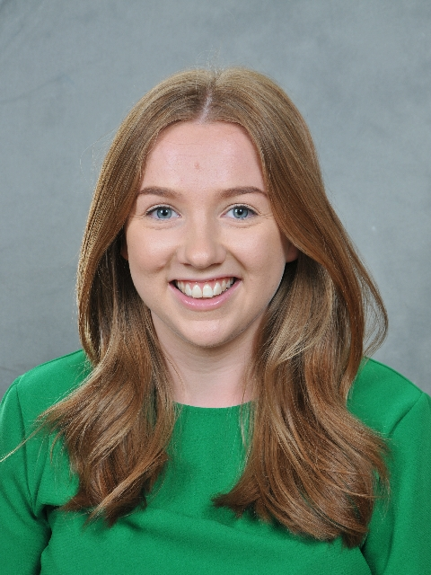
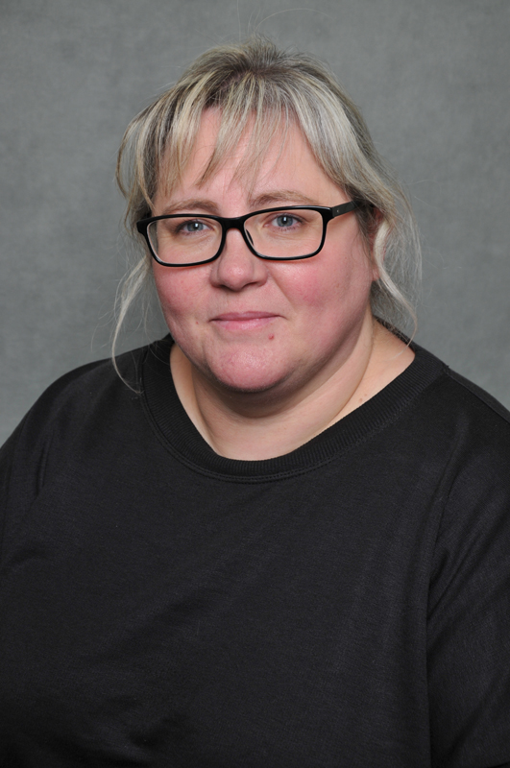
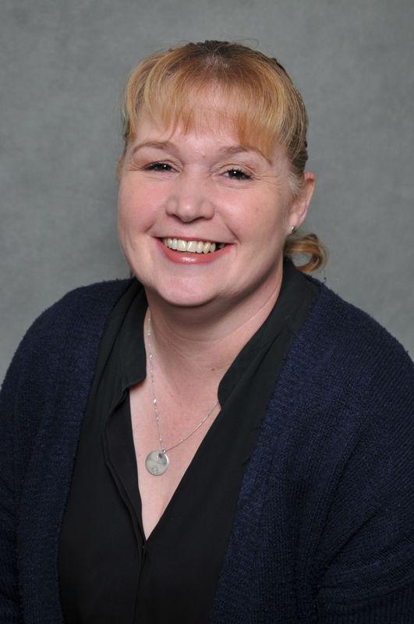
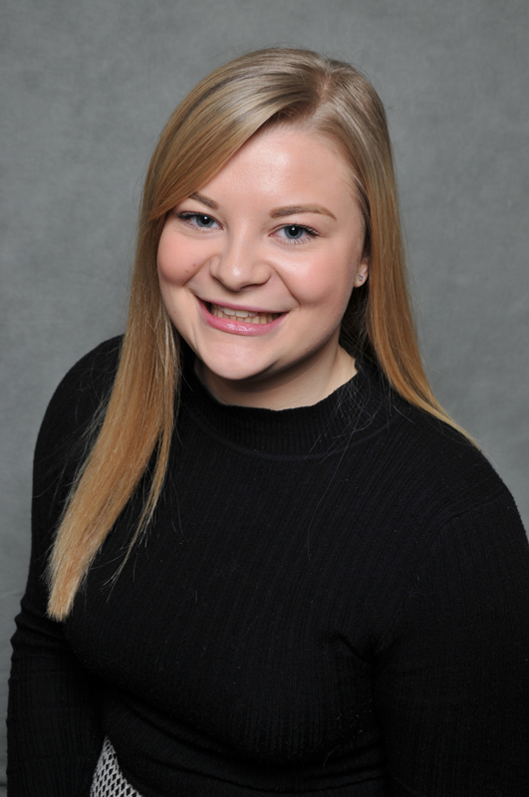
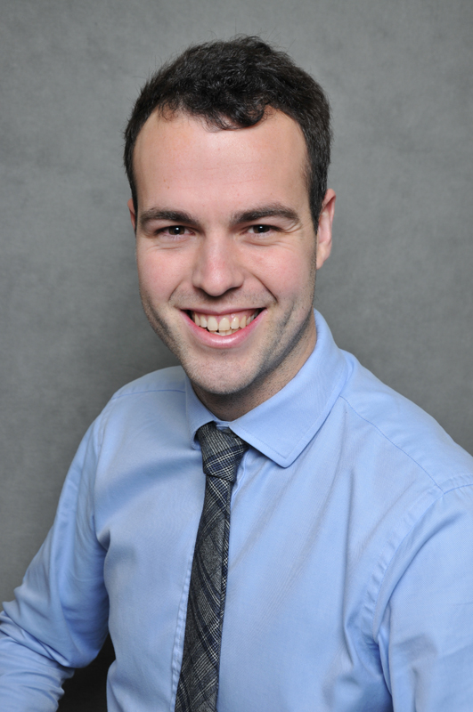
OUR TEACHING STAFF
Mrs Gontaszewska
Reception
Miss Carrigan
Year 1
Ms Bond
Year 2
Miss Daniels
Year 3
Mrs Morrell
Year 4
Mrs Hill
Year 5
Mr Shacklady
Year 6

Slide 9
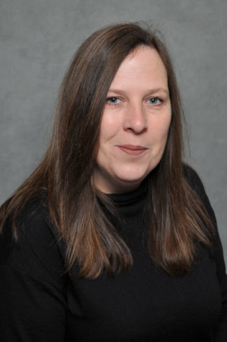
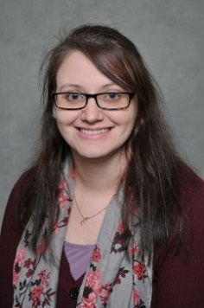
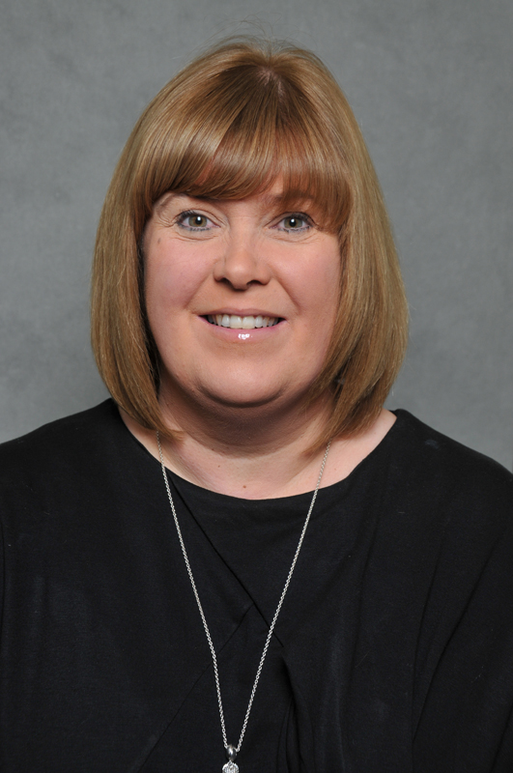
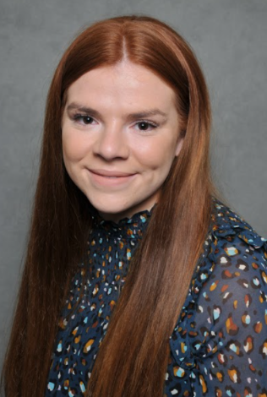
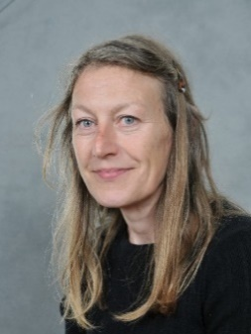
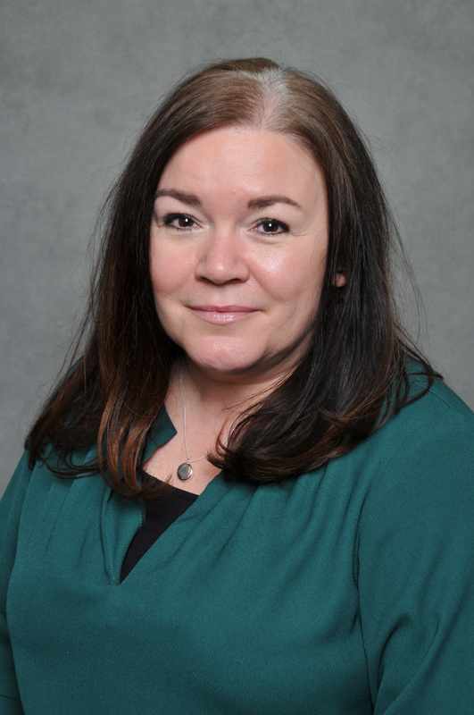
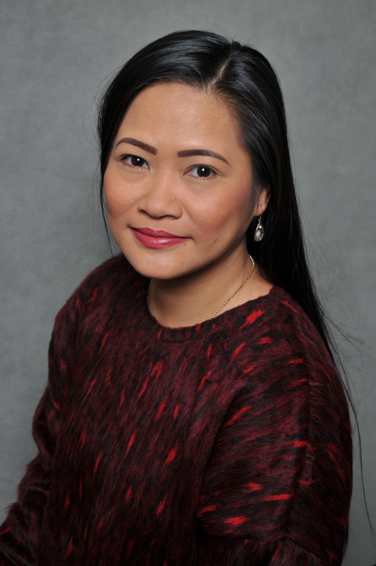

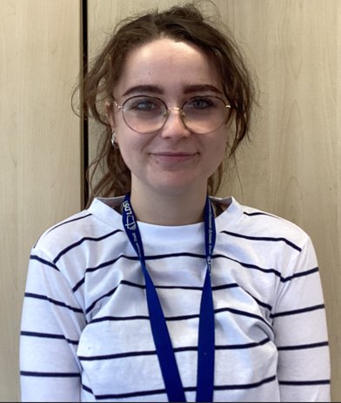
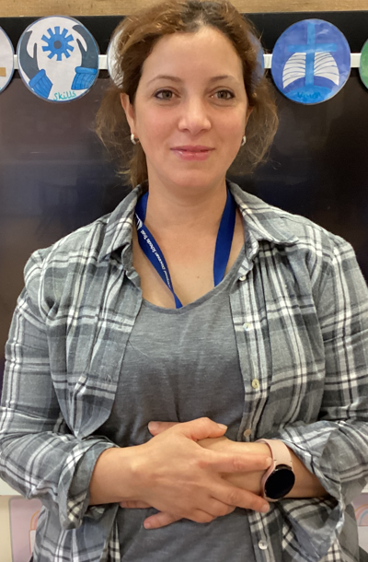
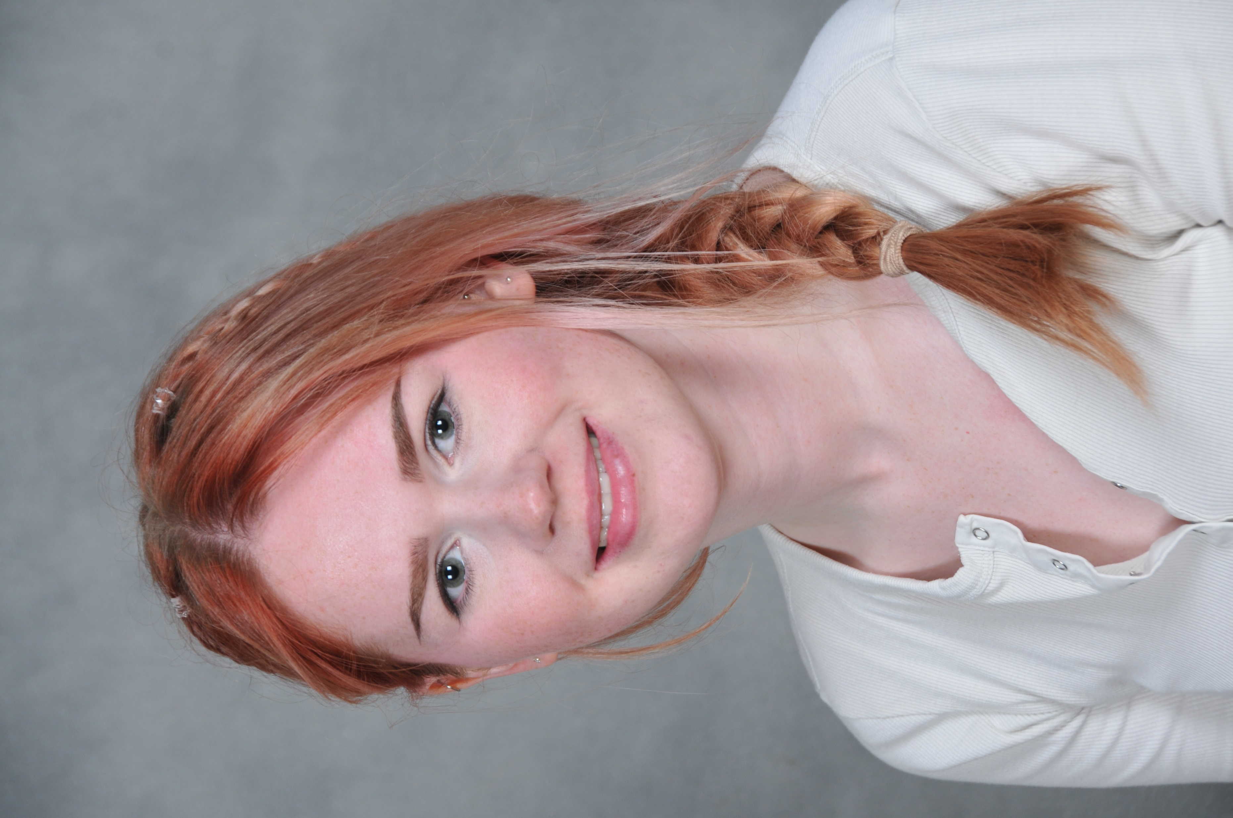
OUR SUPPORT STAFF
Mrs Hannah
Teaching Assistant
Mrs Macneil
Teaching Assistant
Mrs Harwood
Teaching assistant
Mrs Singleton
Teaching Assistant
Mrs Rigby
Teaching Assistant
Mrs Bielby
Teaching Assistant
Mrs Lonsdale
Teaching Assistant
Miss Foreman
Teaching Assistant
Miss Salthouse
Teaching Assistant
Mrs Ben Hassine
Teaching Assistant

Slide 10
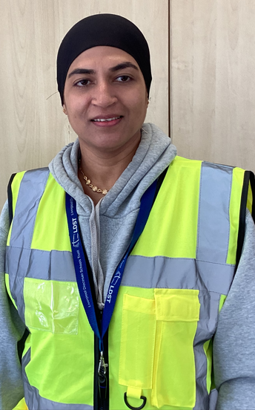
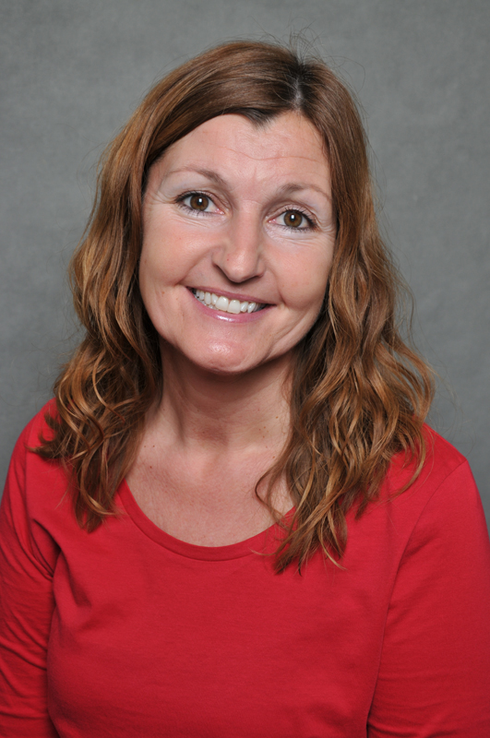
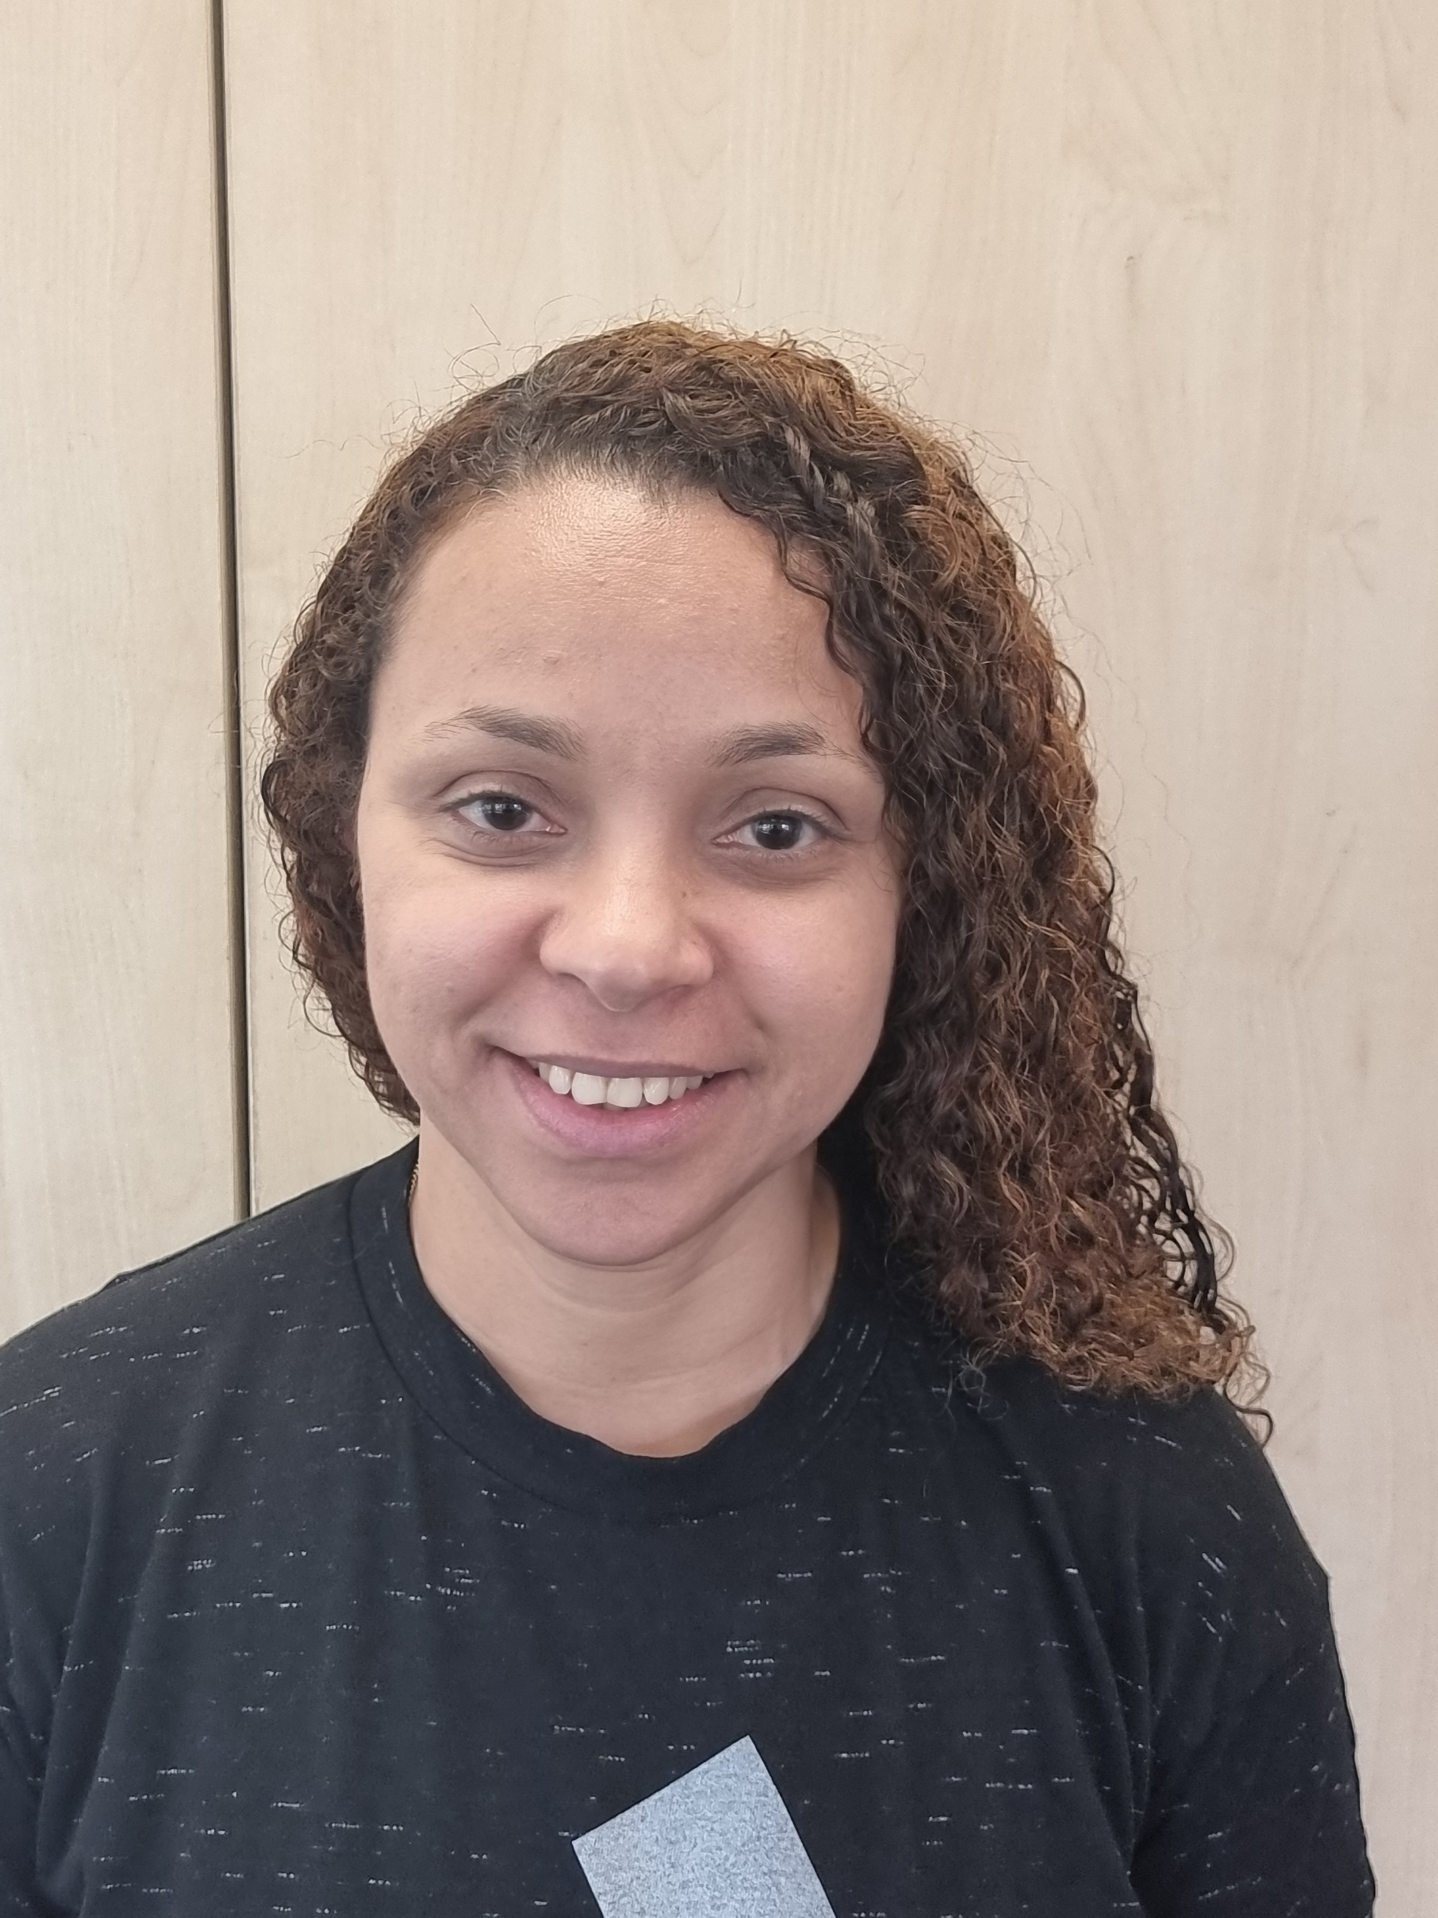
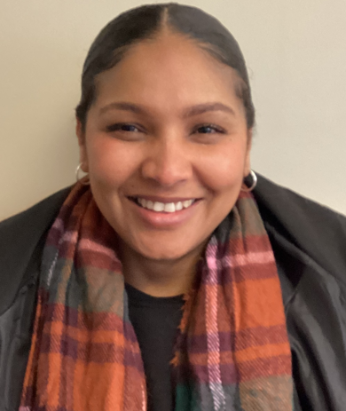
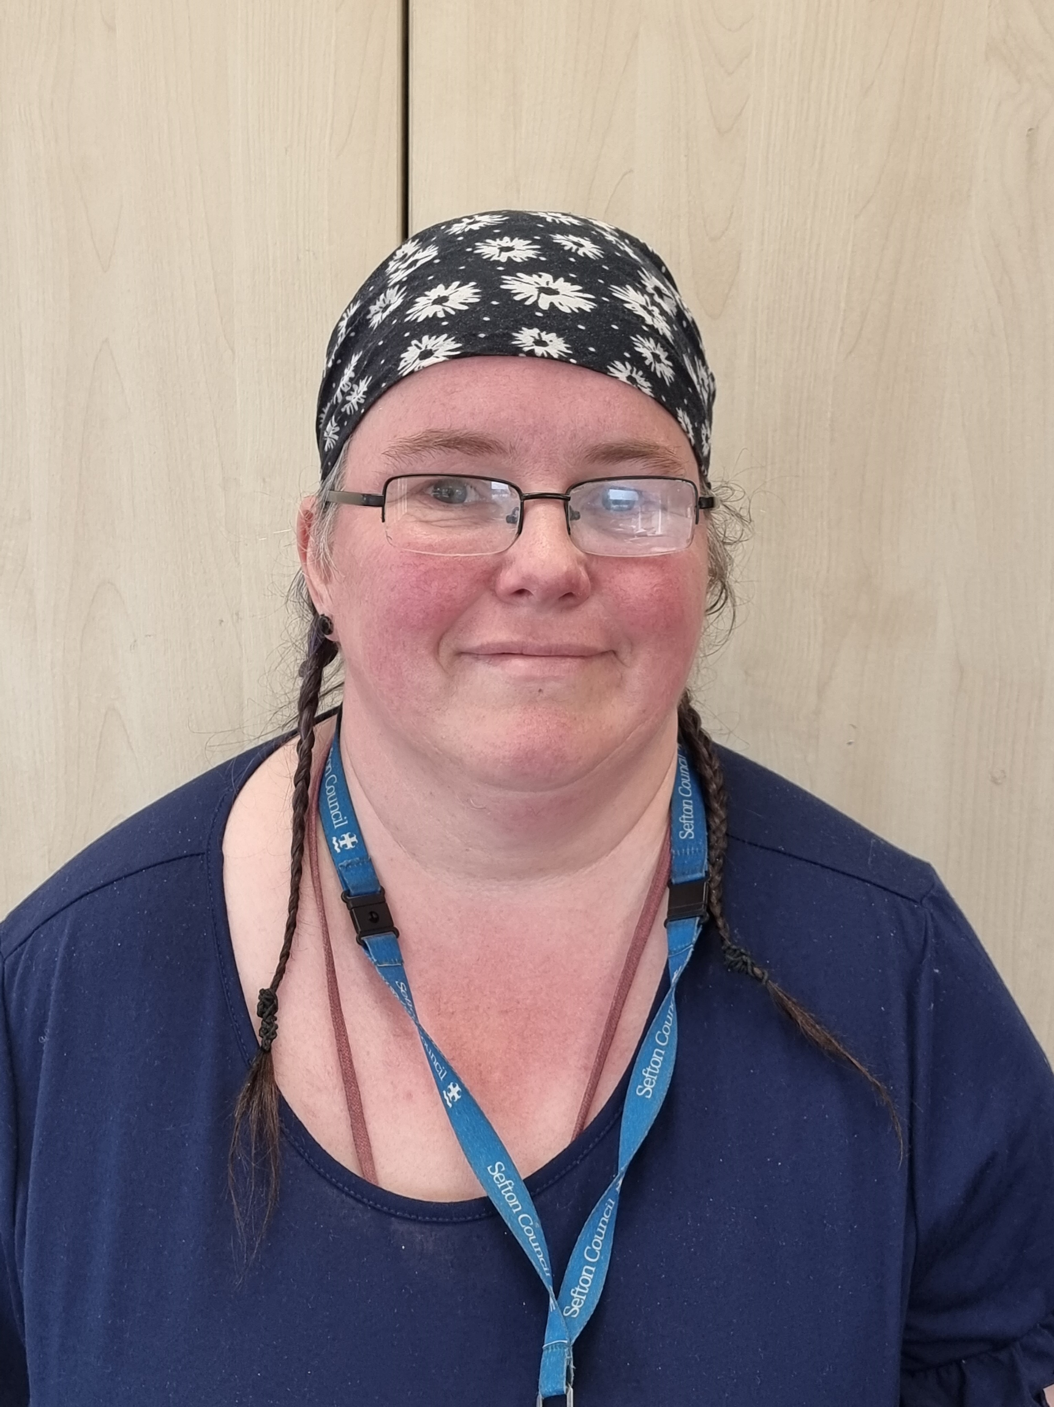
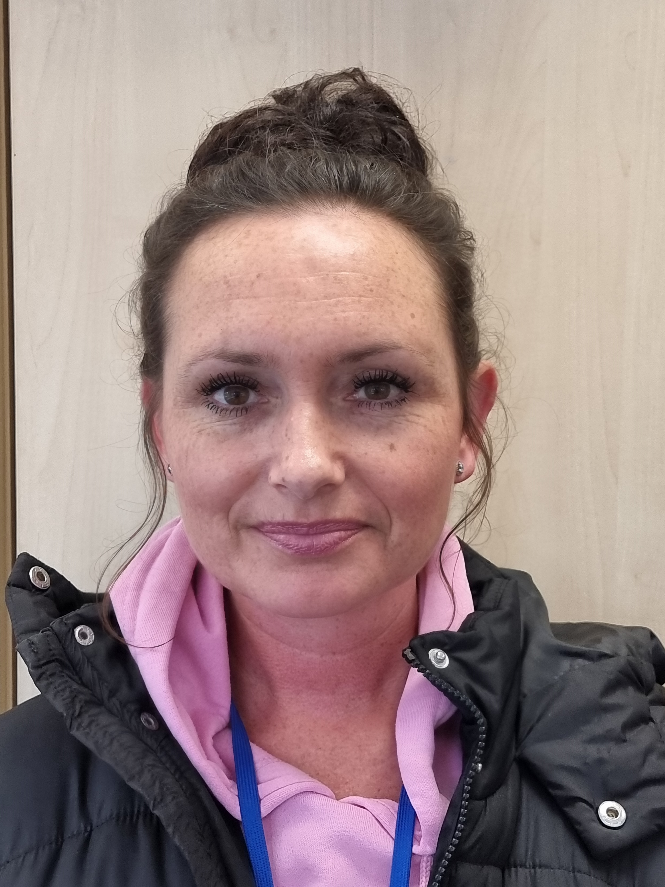
OUR WELFARE STAFF
Mrs Morrell
Year 2
Mrs Tourais
Mrs Farrington
Miss Pimenta
Mrs Hardman
Mrs Dowling
Mrs Mohammed

Slide 11


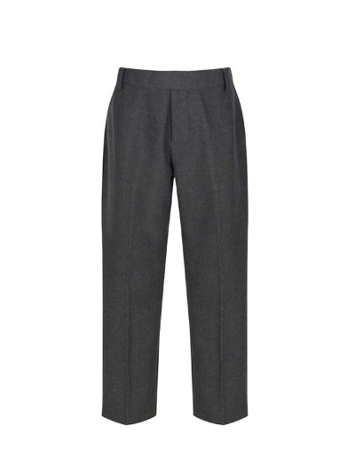
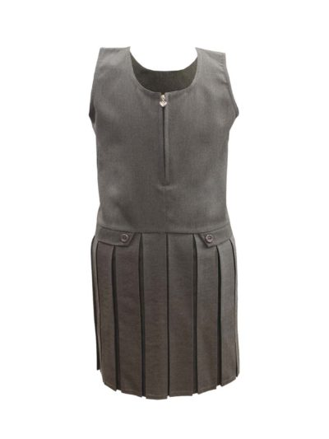
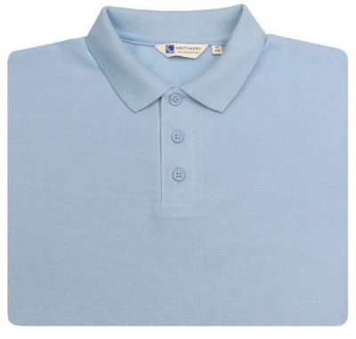
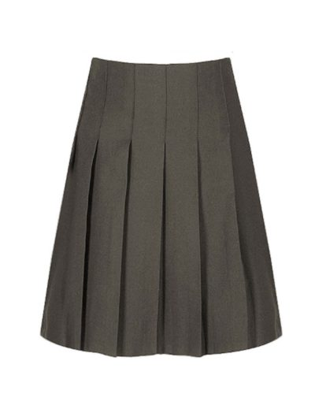
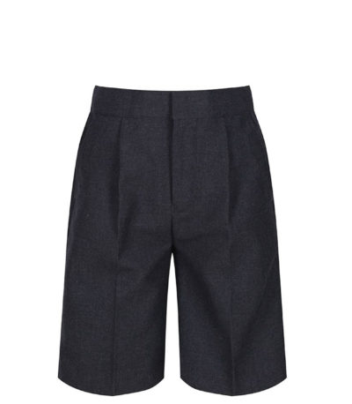
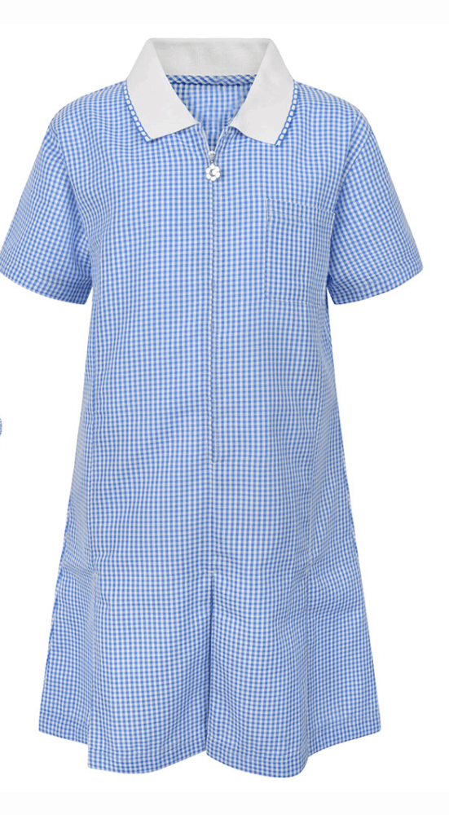
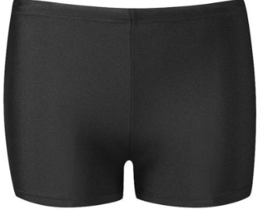





UNIFORM
Our uniform consists of:
Navy blue jumper or cardigan (logo optional); light blue blouse or polo shirt; grey school trousers; skirt or pinafore; white or grey socks or tights; plain black, sensible school shoes (no heels or open toe sandals).
During the summer months, children may wear shorts; a gingham blue and white school dress.
Please make sure all uniform items are labelled with your child’s name.
During years 3-6, children will go swimming once a weeks. This is part of the National Curriculum. Your will be notified when this is due to start for your child’s class.
They will need a swimming bag, towel, swimming hat (available for £2.50 from the office) and either a swimming costume or swimming trunks (not shorts) for boys.

Slide 12

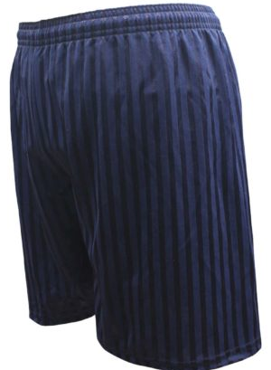
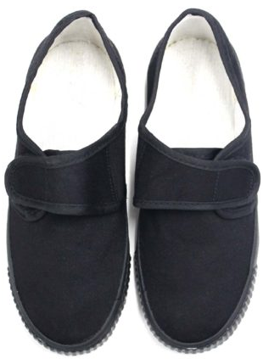
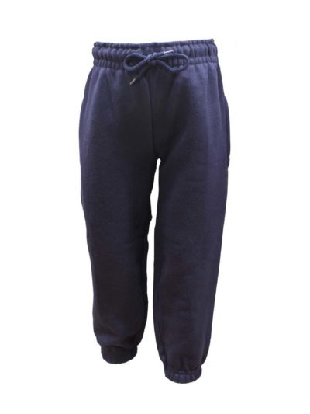


UNIFORM
Our school jumpers and cardigans can be bought from Whittakers or Zips and Snips in Southport with our school logo. Any other plain uniform can be bought from the above stores or any store - such as local supermarkets.
The following items can be bought from the office at any time:
Book Bag - £5.00 PE/Pump Bag - £3.50
PE
Jewellery
In the interest of safety, we ask that your child does not wear jewelry in school. Necklaces, rings, hoop earrings, bracelets etc. can present a hazard in physical activities. The only exceptions to the rule are watches and ear studs. Small stud earrings may be worn in school but must be removed independently by the child for PE and games.
Equipment
Please ensure your child brings a bag each day, to carry their reading books and letters home in, along with a water bottle.
Indoor | Outdoor
Pumps (not trainers for safety reasons) Plain navy blue t-shirt (logo is optional) Navy blue shorts | PE Kit and Trainers, (Tracksuit/joggers and sweatshirt when weather is cold).

Slide 13

MEDICAL INFORMATION
First Aid
All staff have basic First Aid training. Mrs Harwood, Mrs Rankin, Mrs McNeil, Miss Rankin and Mrs Gontaszewka are our Paediatric First Aiders and qualitied in case of a serious accident. The teacher on duty will deal with any minor incidents e.g. bumps, cuts, grazes etc and you will receive an accident form to inform you of this. In the case of a serious accident, first aid will be administered by the Paediatric first aiders. It is vital that your emergency contact details are up to date.
Medication
Teachers are not legally or contractually required to give children medicine, or to supervise them taking it. Those who agree to administer medication, do so voluntary. Only prescription medication can be brought into school and must be in their original container with the pharmacist label. If your child does require medication, then a Medical Administration Form must be completed at the school office.
If your child has a long term or more complex medical condition, a Care Plan will be put in to place to meet your child’s medical needs. For more information, please ask to see the school’s Medical Conditions Policy and contact the school SENDCO to arrange a Care Plan meeting.
School Nurse
Our School Nurse is Liz Keighley.
Liz is available to offer support and advice if it is needed. Liz also runs a school drop-in session once a month. School will inform you of these dates in advance. You can also contact the school nurse through the office or Mrs Rees.
Mrs Rees is a Teaching Assistant and also our Family Link Worker.
Contact: 07957 111 165 (Family Link Worker)

Slide 14
PAEDIATRIC FIRST AIDERS
Mrs Harwood
Teaching Assistant
Mrs Gontaszewska
Reception Teacher
Mrs Macneil
Teaching Assistant
Mrs Rigby
Teaching Assistant

Slide 15

ATTENDANCE
Attendance Matters! Your child must attend school regularly and on time. Our school target is for all pupils to have 100% attendance, with a minimum expectation that all pupils will achieve at least 97%.
If your child is going to be absent or late, you must contact school immediately to inform us. You can contact school by ringing and leaving a message or by messaging on class dojo. If we have not heard from you, a member of our Attendance Team will ring you.
Please ensure the school office have a minimum of three emergency contact details. If we are unable to make contact with you, our Attendance Team will do a home visit.
At Holy Trinity Primary School, we are always here to support you with any difficulties regarding attendance or punctuality.
If you require support please don’t hesitate to contact Mrs Thompson or our Learning Mentor, Mrs Rankin.
Our Attendance Team: Mrs Rankin, Mrs Redmond, Mrs Wood, Mrs Thompson.
Attendance | Description | Approx. days lost per year
97% - 100% | Meeting our school target | Up to 5 days of lost learning
90% - 96.9% | Below our school target | Between 6 and 19 days of lost learning
Less than 90% | Significantly below our school target. Serious impact on education and learning. This is classed as ‘Persistent Absence’. | 20 or more days of lost learning

Slide 16
CHILDREN’S SAFETY
We would like to draw your attention to procedures which are in place to ensure both children and adults are safe whilst on the school site.
MORNINGS
The school gates open at 8.40am to welcome families onto our playgrounds, they close at 9:00am. A member of staff will be available on the gate to welcome families and be on hand for you to ask any questions or share any information if required. Children are to stay with their parent or carer until the class teacher arrives to collect your child. To avoid unknown adults entering school, we ask parents and carers to say their goodbyes to children outside and for children to come into classrooms with their teachers. Any parent wishing to visit the school office must enter via the office entrance.
OFFICE DOOR
The main building entrance door will be locked to control access. Any parent wishing to enter must press the buzzer and a member of staff will release the door lock. Please be patient if you have to wait.
PLAYGROUND
We encourage children to use their bikes and scooters to come to school. However, in order to ensure that all children are safe on site we request the following:
• Bikes and scooters are pushed along the pathways at all times.
• Bikes and scooters are placed in the bike park from 8.50am.
• Bikes and scooters are not used on the playground after school.
• Please ensure you are with your child and take full responsibility for them before and after school.
HOME TIME
The Infant gates will open at 3.05pm and the junior gates at 3:15pm by a member of staff. We understand that there will be occasions where you have arranged for friends or relatives to collect your child at the end of the day. Please ensure you let us know who will be collecting your child on your behalf. We will not be able to release your child to someone other than you without your consent to do so. When your child starts school, you will be asked to complete a ‘collection form’, on here you can let us know which adults can collect your child. Please contact our office to inform us of any changes to the adult who is collecting your child.
DOGS
Dogs are not allowed on our school site. You will not be permitted entrance through the school gates with a dog.

Slide 17

TERM DATES
HOLY TRINITY CE PRIMARY SCHOOL
SCHOOL TERM AND HOLIDAYS 2025-2026
(All Dates Inclusive)
* INSET Day - INSET (In-service Education and Training) days are a series of days, normally 5 per academic year, during which children do not attend and staff receive professional development.

Slide 18

SCHOOL MENU

Slide 19

Breakfast and After School Clubs

